Slide 1

Capturing Spatial Dependencies with Deep Neural Networks II
Yao-Yi Chiang
Computer Science and Engineering
University of Minnesota
yaoyi@umn.edu
CC-BY
Attribution

Slide 2
Semantic Segmentation and Object Detection
A short introduction

Slide 3
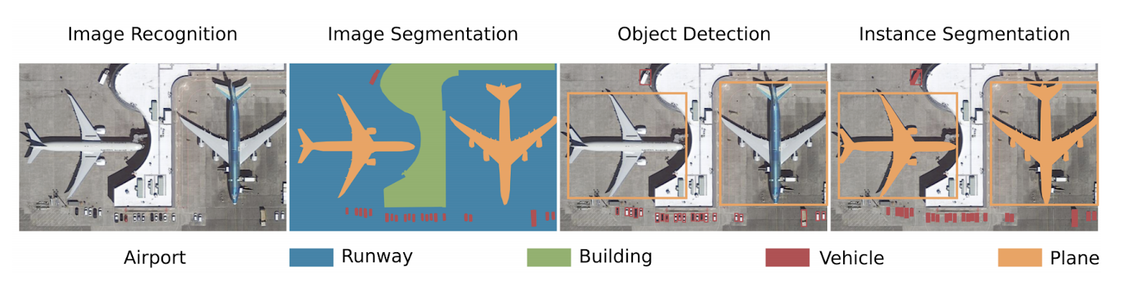
Recall: Overhead Imagery Understanding Tasks
Thorsten Hoeser and Claudia Kuenzer. 2020. Object detection and image segmentation with deep learning on earth observation data: A review-part i: Evolution and recent trends. Remote Sensing. Retrieved from https://www.mdpi.com/723500

Slide 4
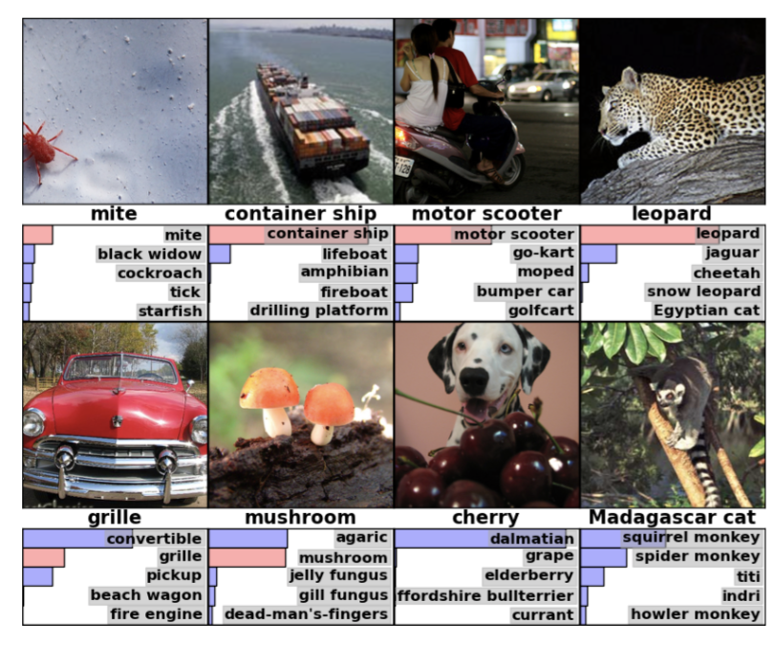
CNN so far - Image Classification
Take an input image, predict an object class
https://blog.acolyer.org/2016/04/20/imagenet-classification-with-deep-convolutional-neural-networks/

Slide 5
Semantic Segmentation

Slide 6
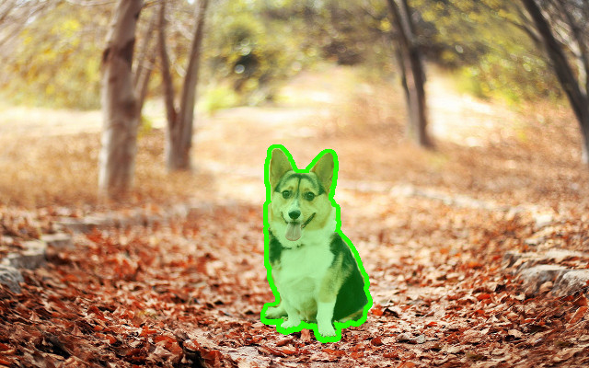
Semantic Segmentation
Output a class map for each pixel (here: dog vs background)
Also, instance segmentation: specify each object instance as well (two dogs have different instances)
This can be done through object detection + segmentation

Slide 7
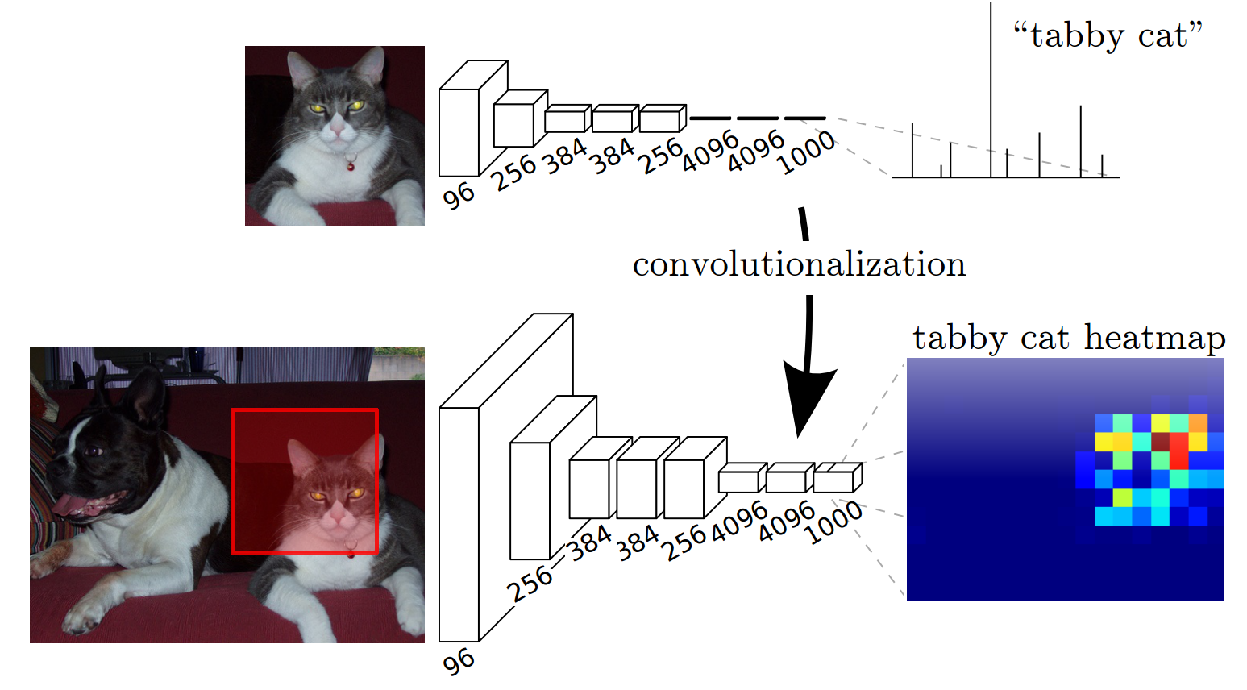
Sliding Window
Every window provides some context for classifying the center pixel
Inefficient, why?

Slide 8
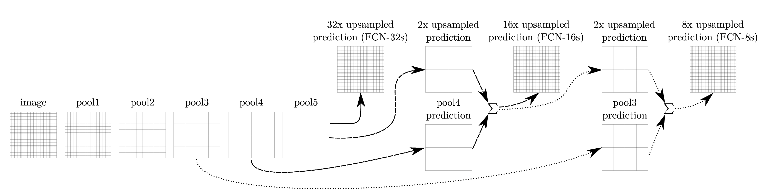
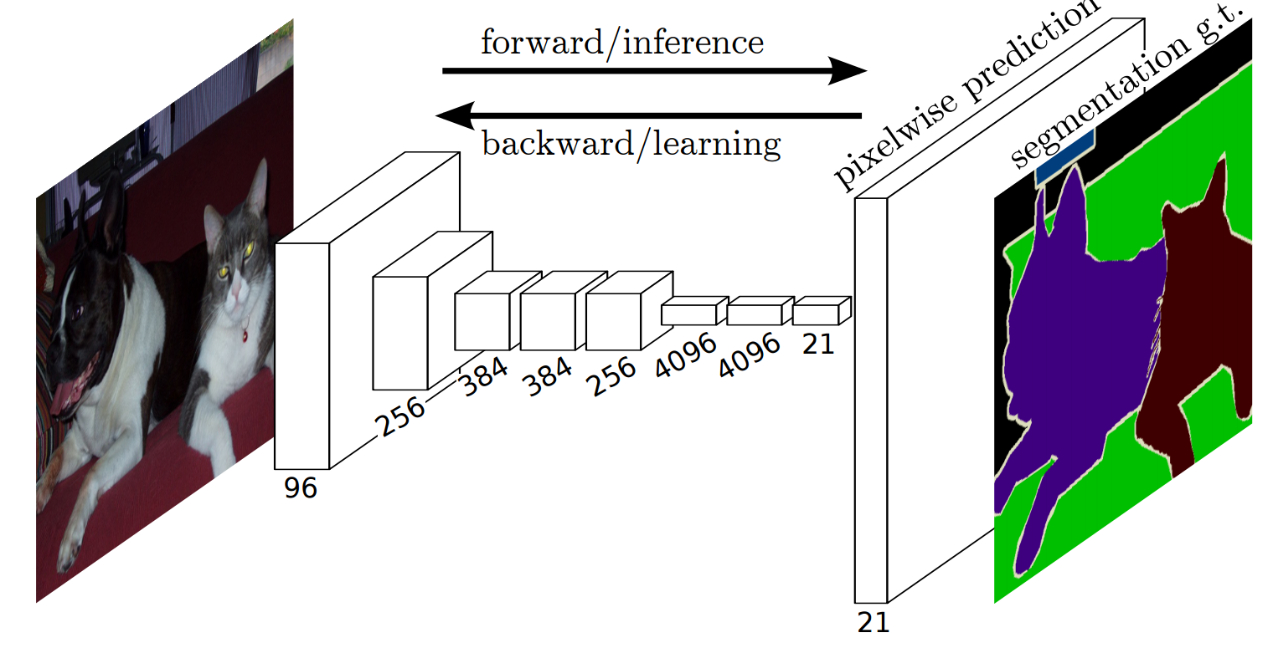
Fully Convolutional Network (FCN)
Predict / backpropagate for every output pixel
Aggregate maps from several convolutions at different scales
Upsampling/unpooling back to dense pixels for classification
Long, Jonathan, et al. "Fully convolutional networks for semantic segmentation." CVPR 2015
Noh, Hyeonwoo, et al. "Learning deconvolution network for semantic segmentation." ICCV 2015

Slide 9
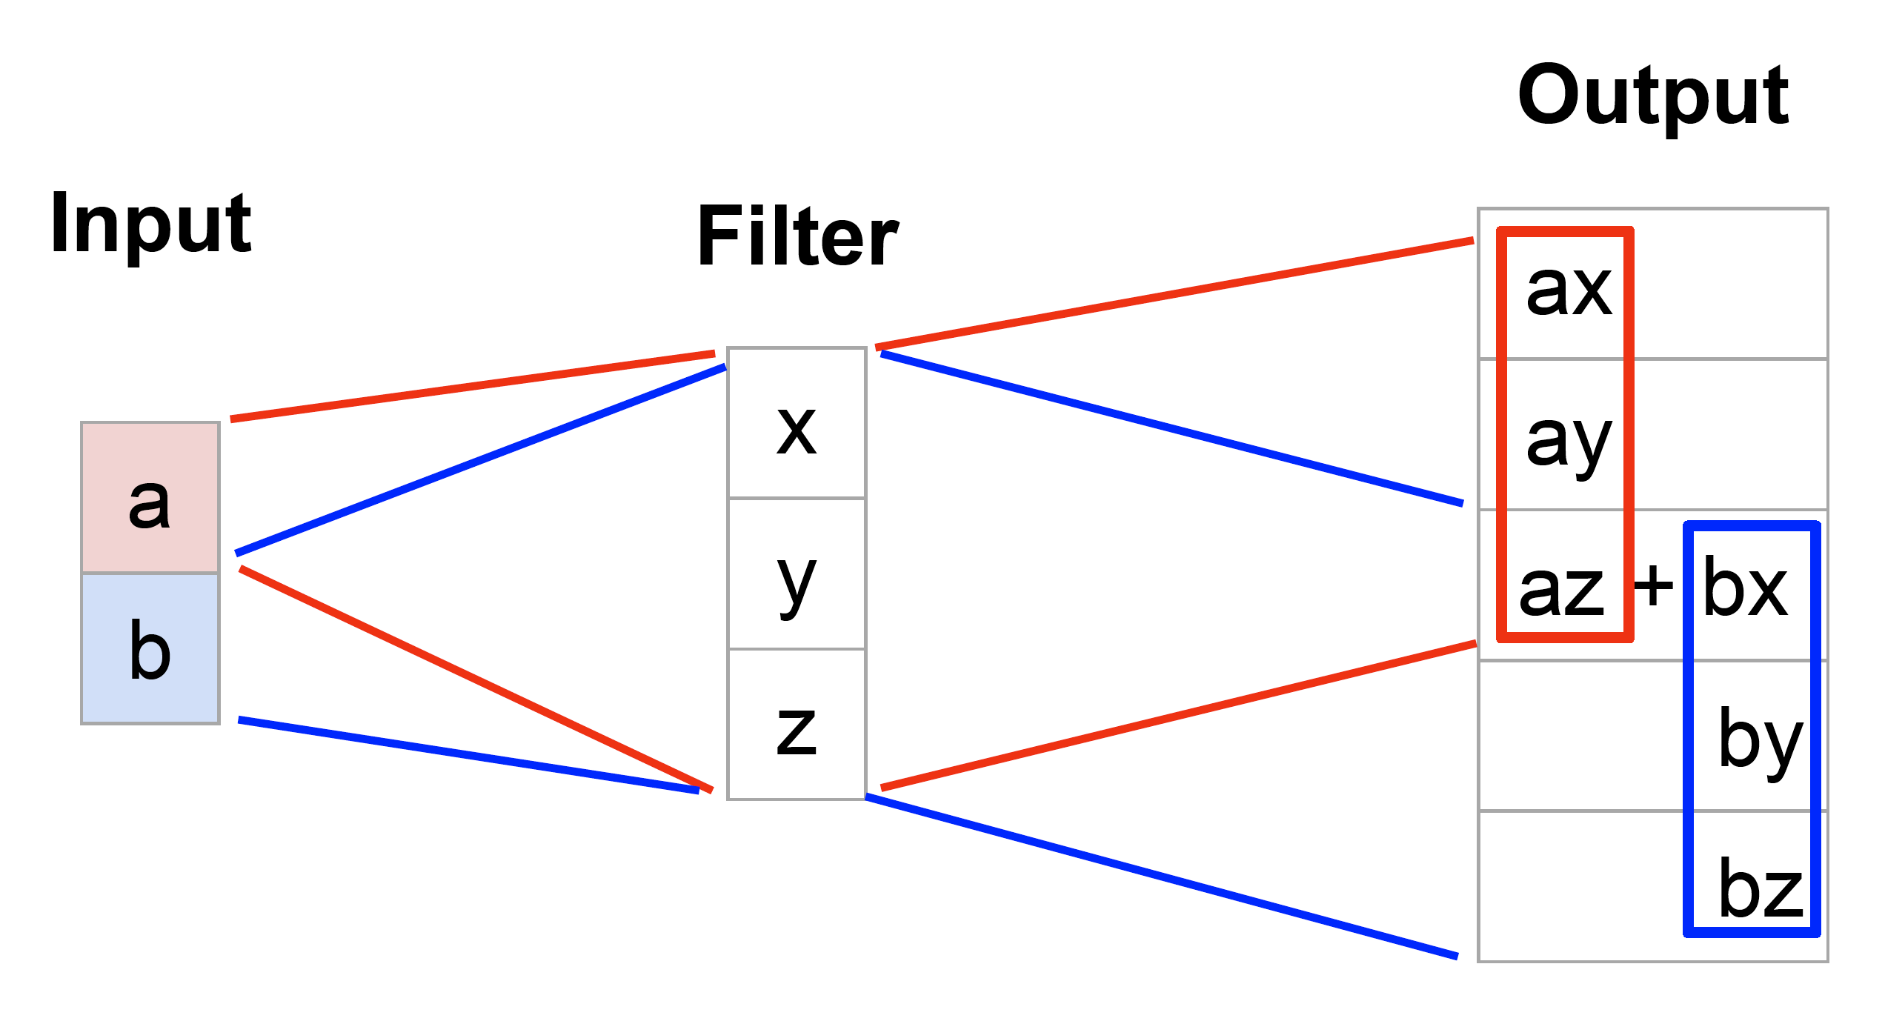
Learnable Upsampling
1D Example
Fei-Fei Li, Ranjay Krishna, Danfei Xu. Lecture 15

Slide 10
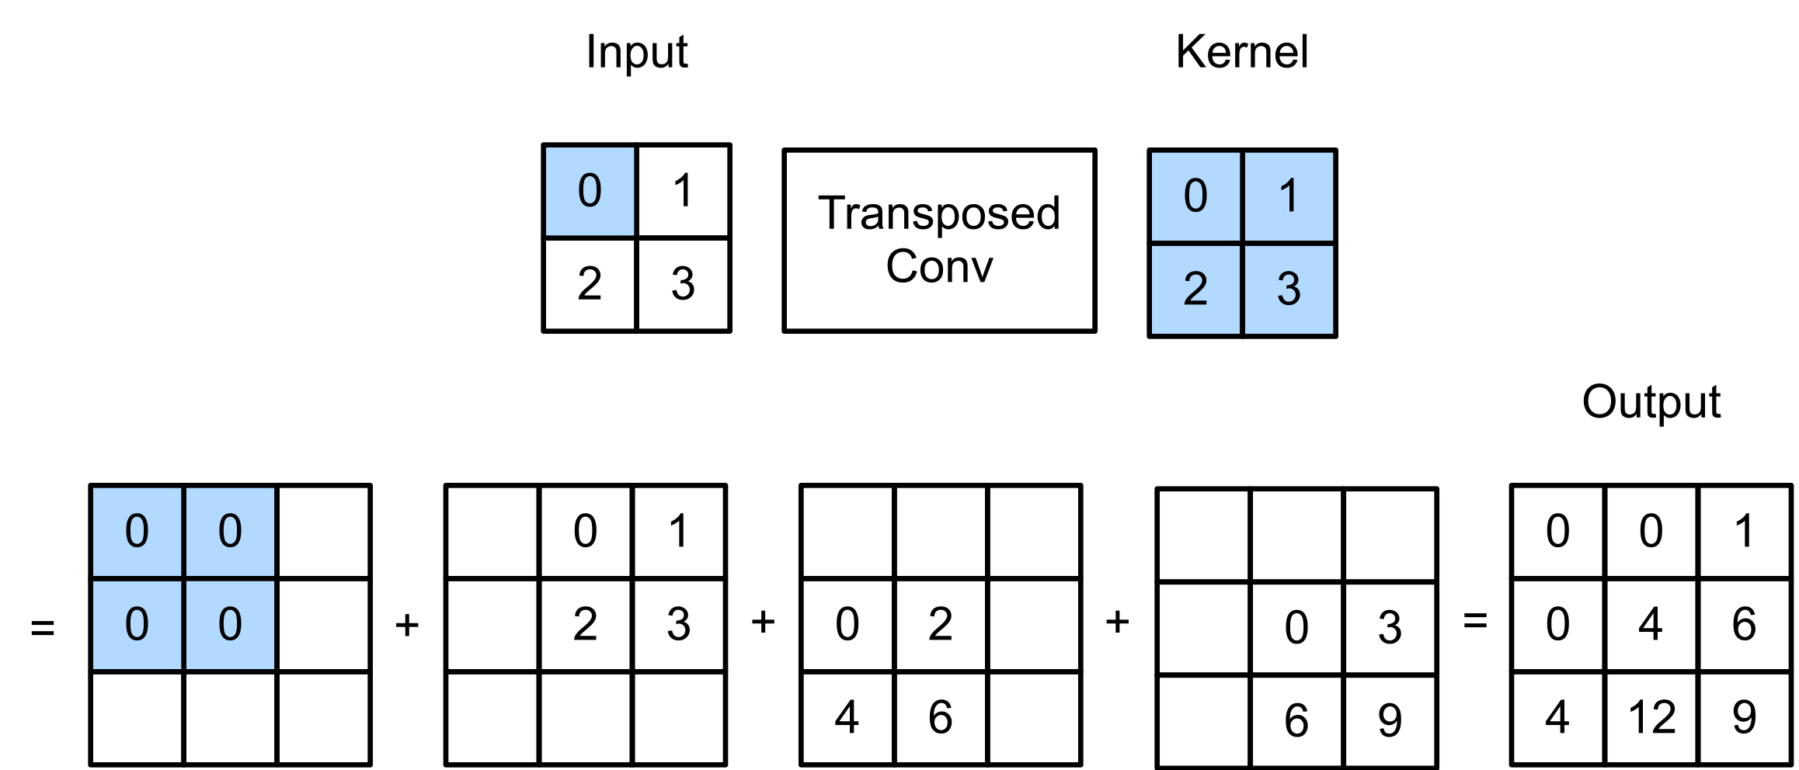

Learnable Upsampling: Transposed Convolution
https://d2l.ai/chapter_computer-vision/transposed-conv.html

Slide 11

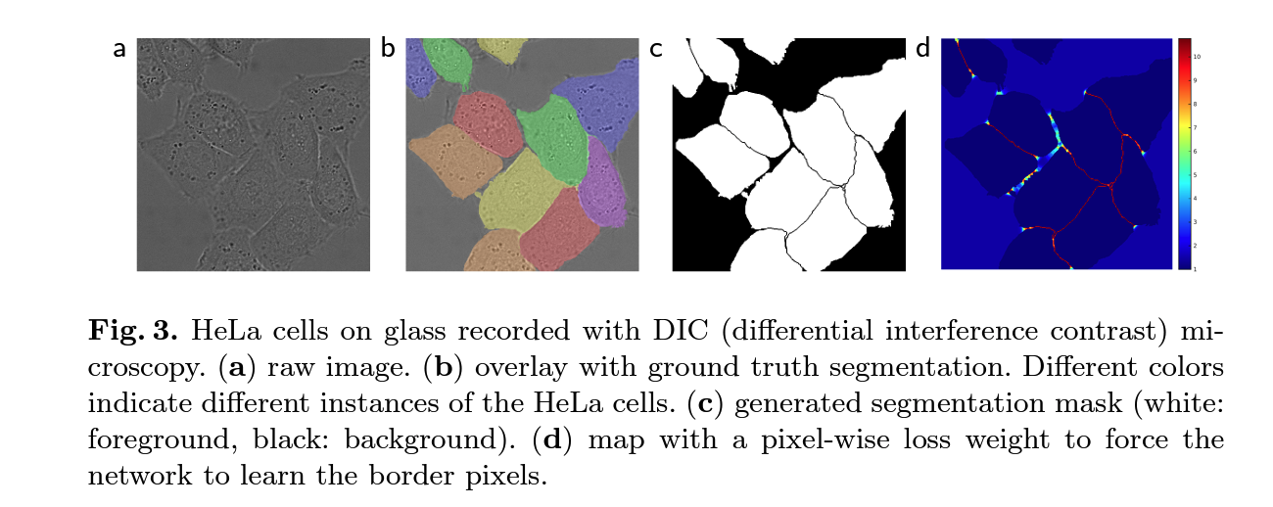
U-Net
Skip connections between corresponding convolution and deconvolution layers
Sharper masks by using precise spatial information (early layers)
Better object detection by using semantic information (late layers)
Weighted loss for clear boundaries

Slide 12
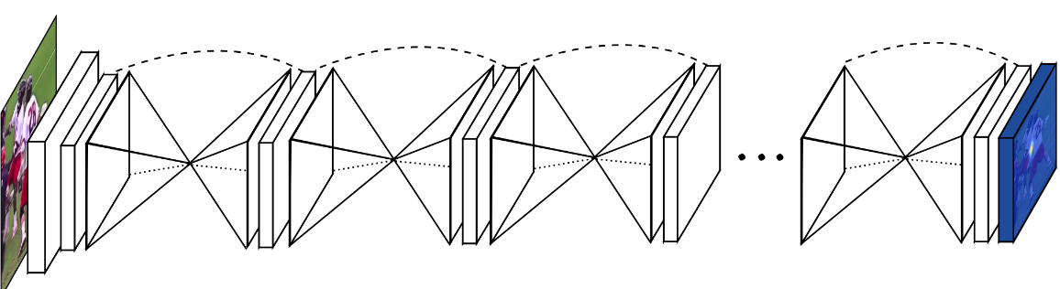
Hourglass Network
U-Net like architectures repeated sequentially
Each block refines the segmentation for the following
Each block has a segmentation loss
Notes:
See also Dice Loss: https://www.jeremyjordan.me/semantic-segmentation/#loss

Slide 13

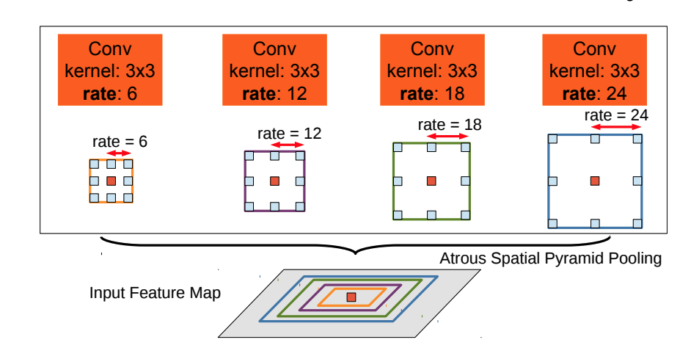
DeepLab V3
Atrous convolutions, or dilated convolutions
Arbitrarily enlarge the field-of-view of filters
Compute the responses of any layer at any desirable resolution
Atrous Spatial Pyramid Pooling (ASPP)
To classify the center pixel (orange), ASPP exploits multi-scale features by employing multiple parallel filters with different rates
The effective Field-Of-Views are shown in different colors
https://arxiv.org/abs/1606.00915v2

Slide 14
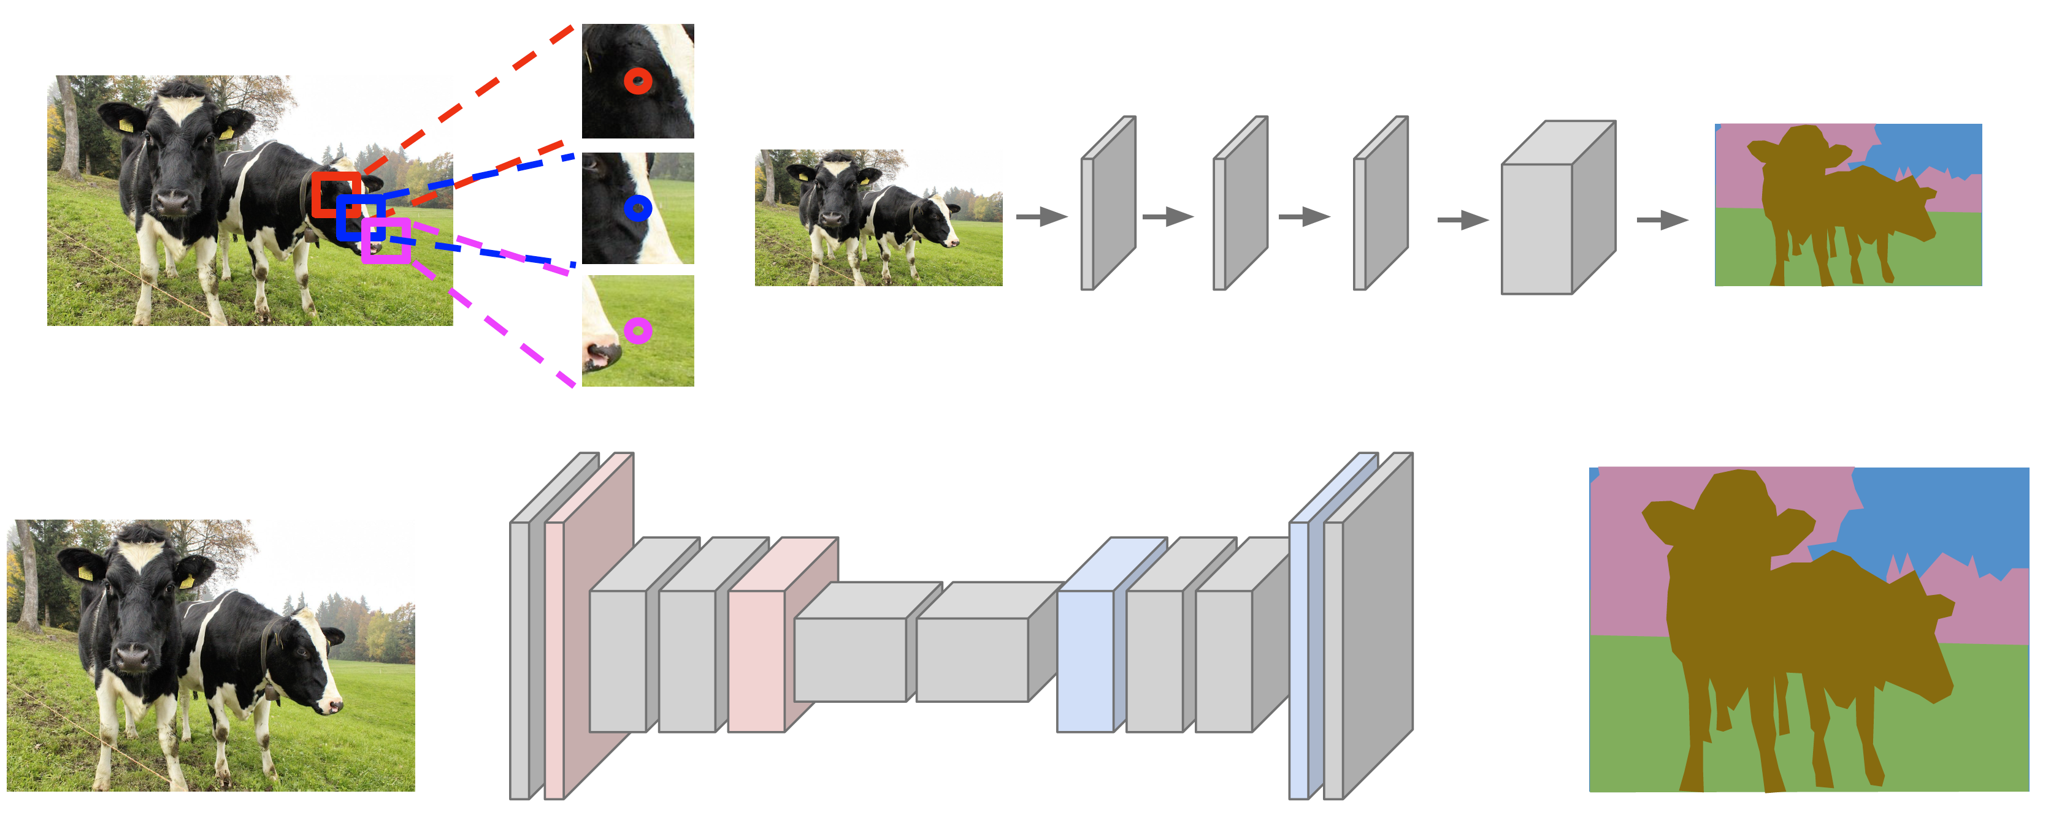
Semantic Segmentation Summary
Fei-Fei Li, Ranjay Krishna, Danfei Xu. Lecture 15

Slide 15
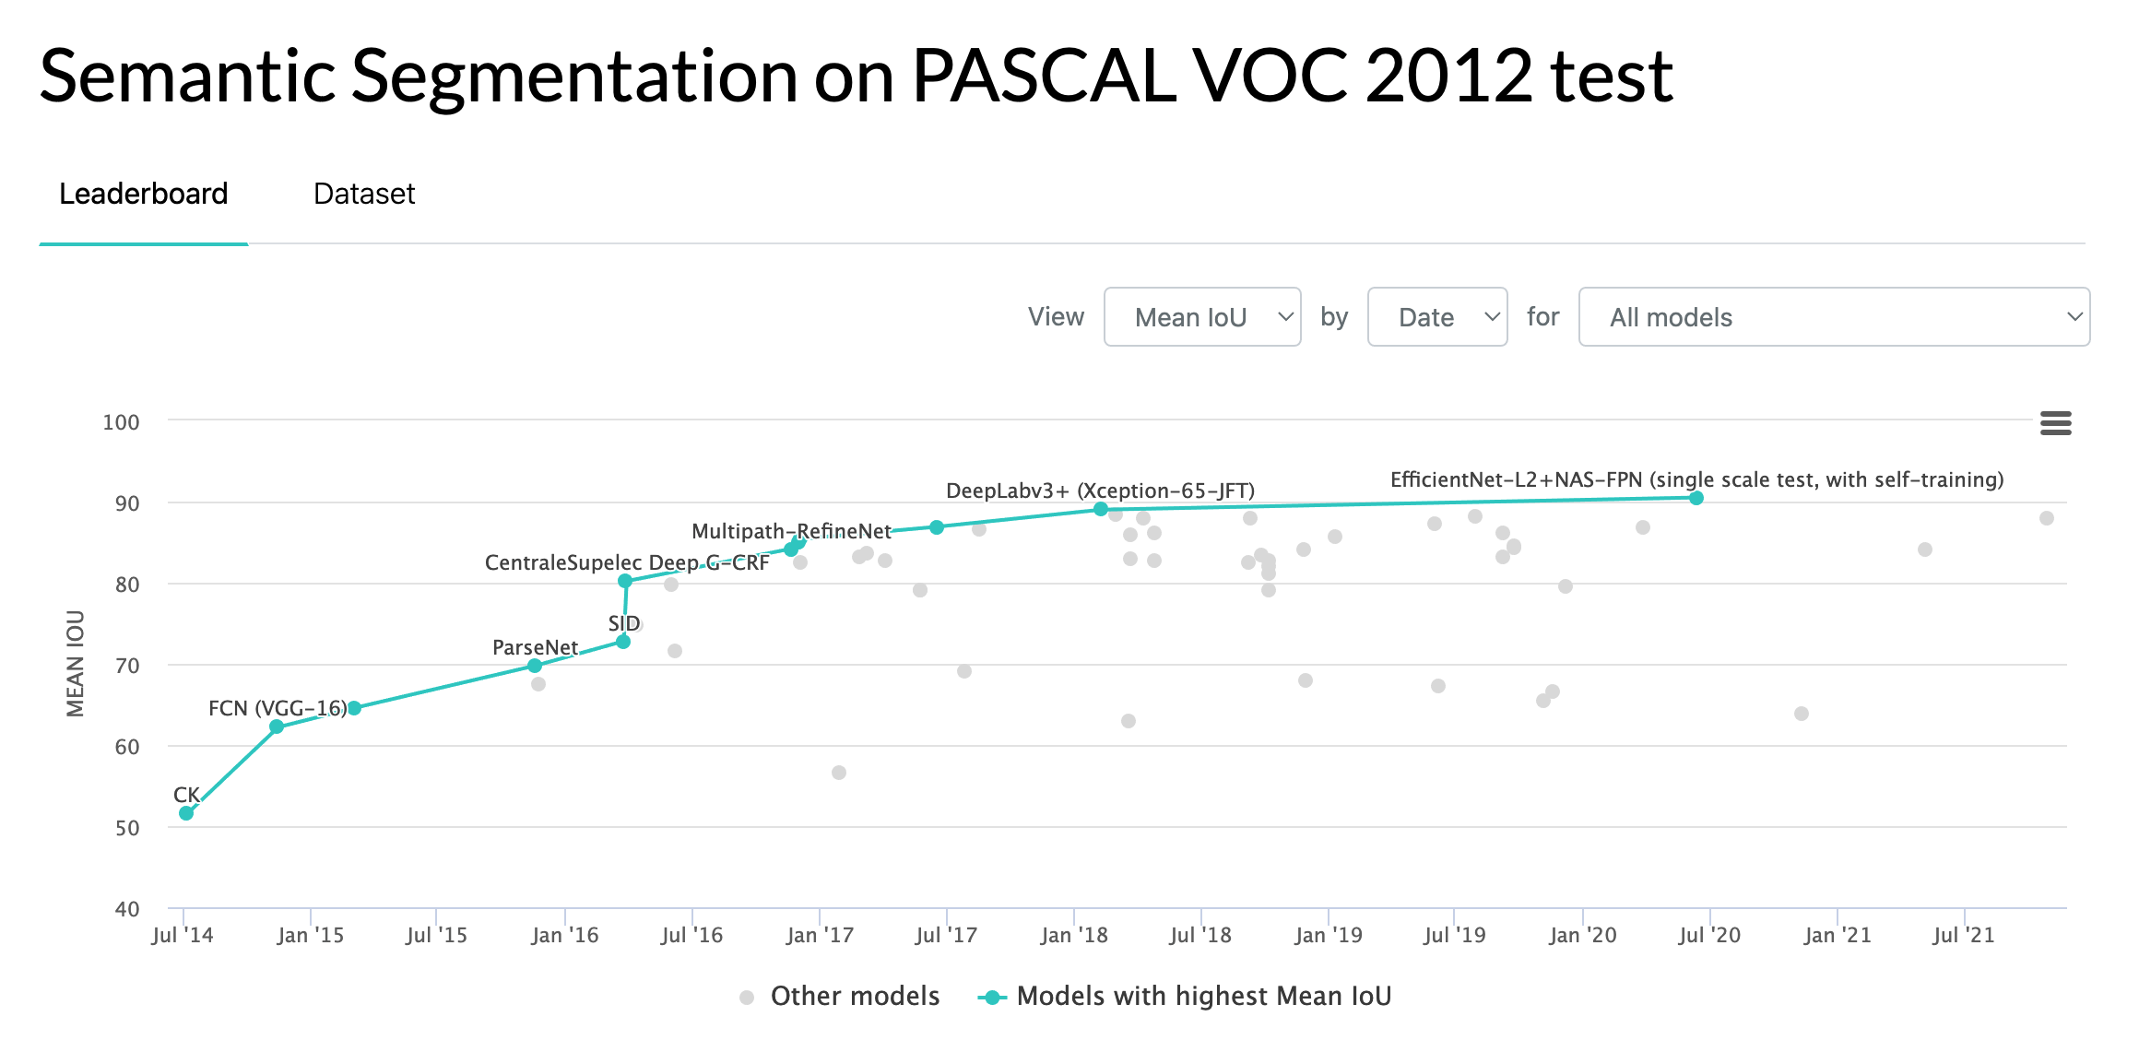
https://paperswithcode.com/sota/object-detection-on-coco

Slide 16
Object Detection

Slide 17
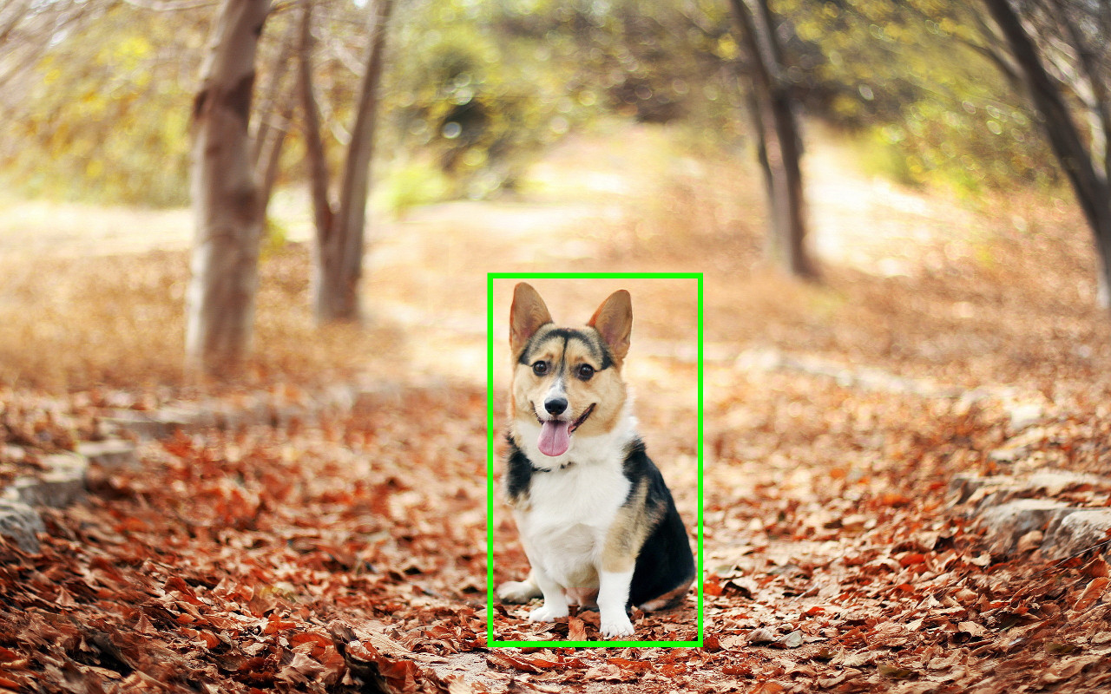
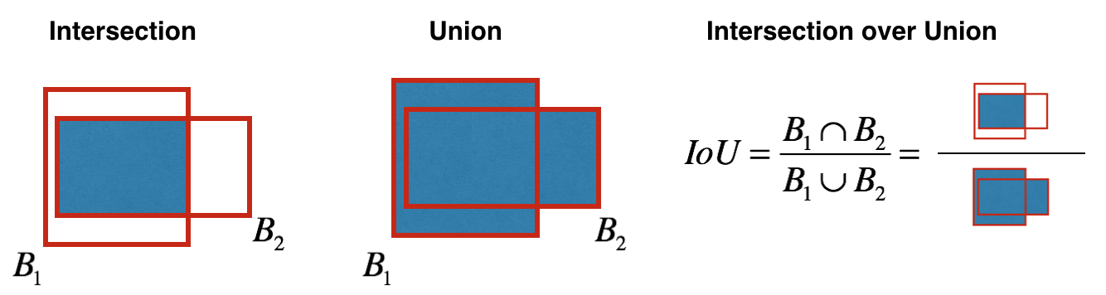
Localization
Single object per image
Predict coordinates of a bounding box (x, y, w, h)
Evaluate via Intersection over Union (IoU) (Jacard Similarity)

Slide 18
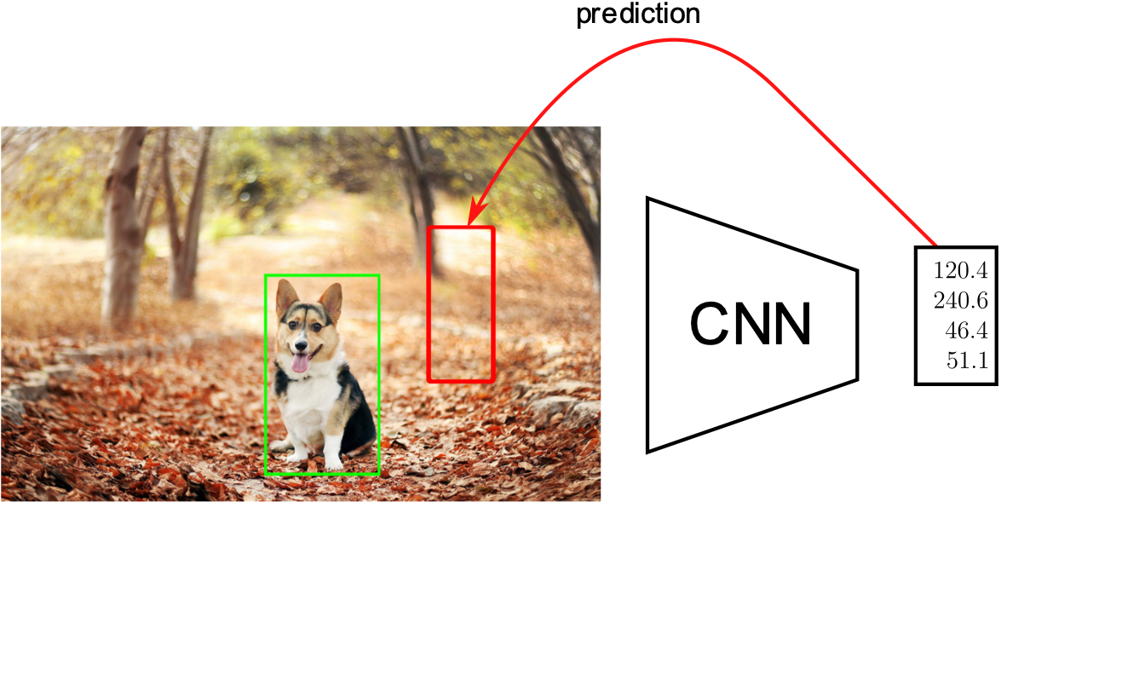
Localization as regression

Slide 19
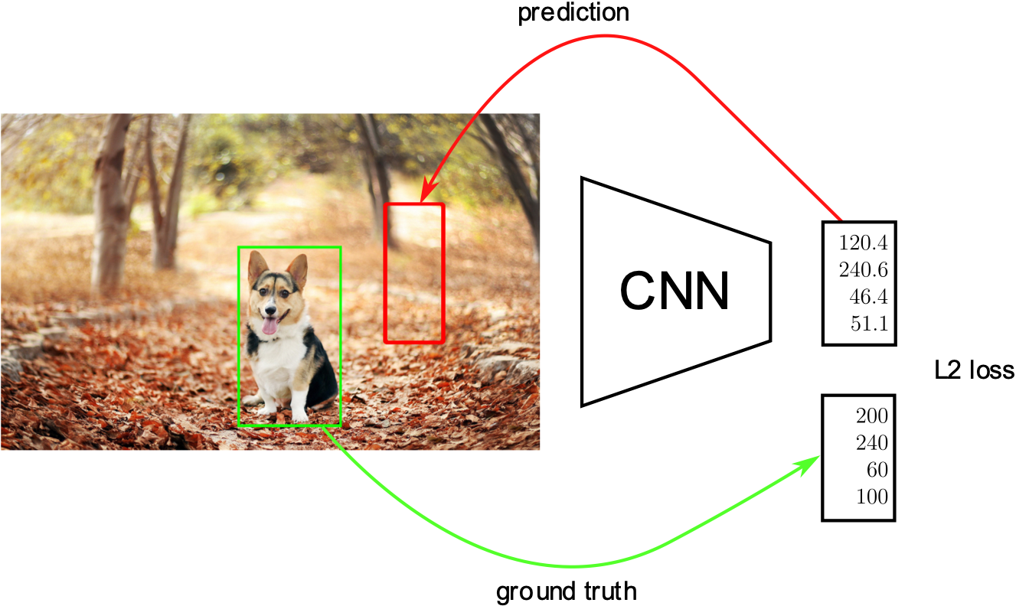
Localization as regression
the sum of the all the squared differences between the true value and the predicted value

Slide 20
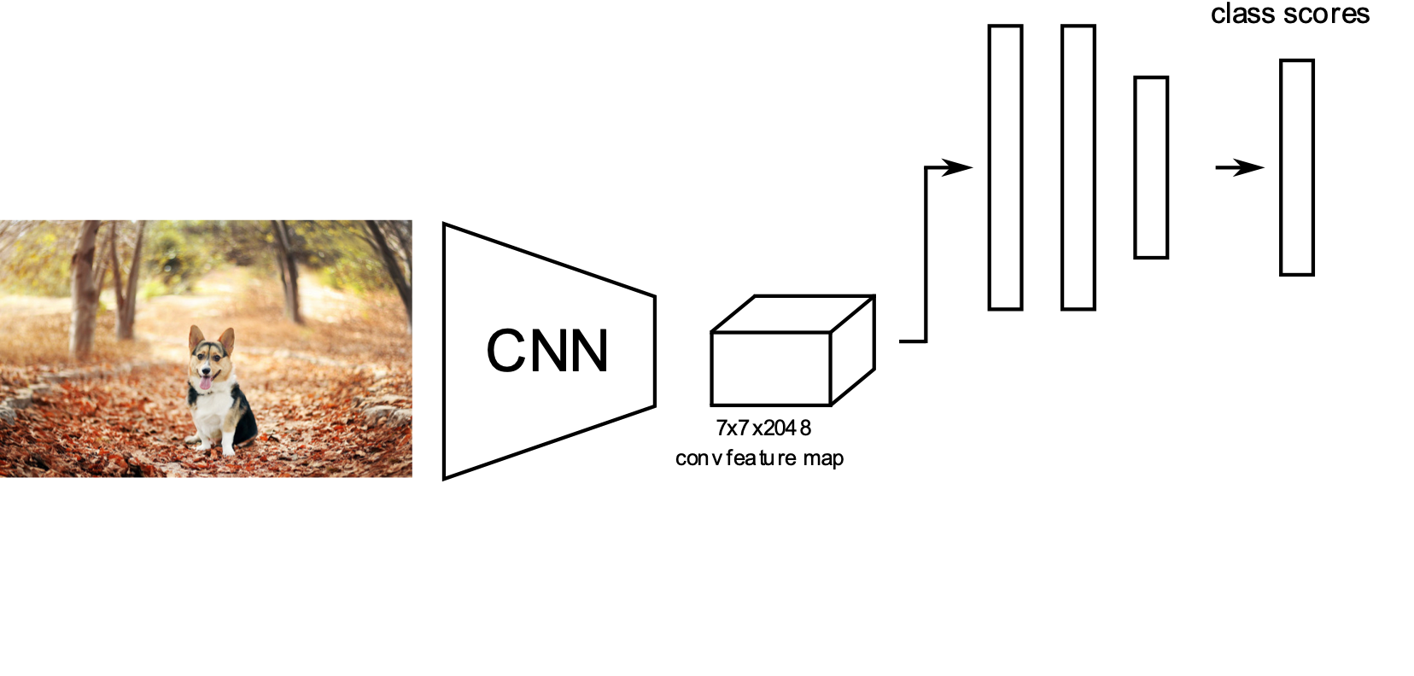
Classification + Localization

Slide 21
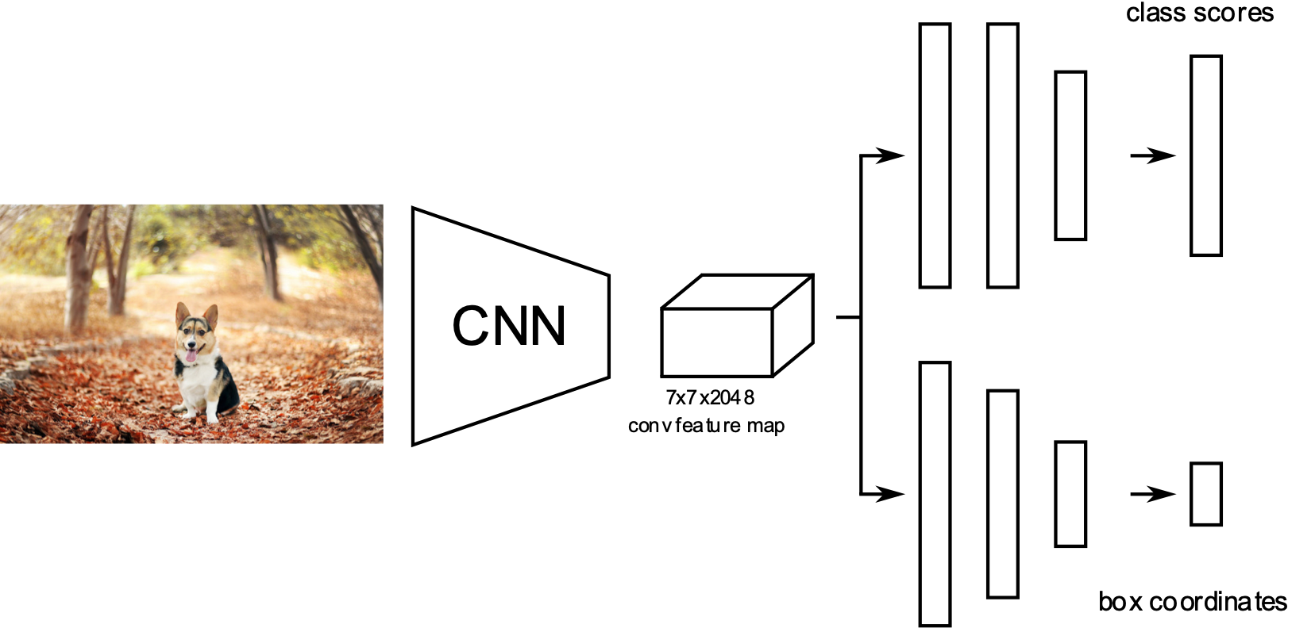
Classification + Localization
Use a pre-trained CNN on ImageNet (e.g., ResNet)
The "localization head" is trained separately with regression (i.e., generate coordinates in a continuous space)
Possible end-to-end finetuning of both tasks
At test time, use both heads

Slide 22
Classification + Localization
C classes, 4 output dimensions (1 box)
Predict exactly N objects: predict (N×4) coordinates and (N×K) class scores

Slide 23
Object Detection
We don't know in advance the number of objects in the image.
Object detection relies on object proposal and object classification
Object proposal: find regions of interest (RoIs) in the image
Object classification: classify the object in these regions
Two main families:
Single-Stage: A grid in the image where each cell is a proposal (SSD, YOLO, RetinaNet)
Two-Stage: Region proposal then classification (Faster-RCNN)

Slide 24
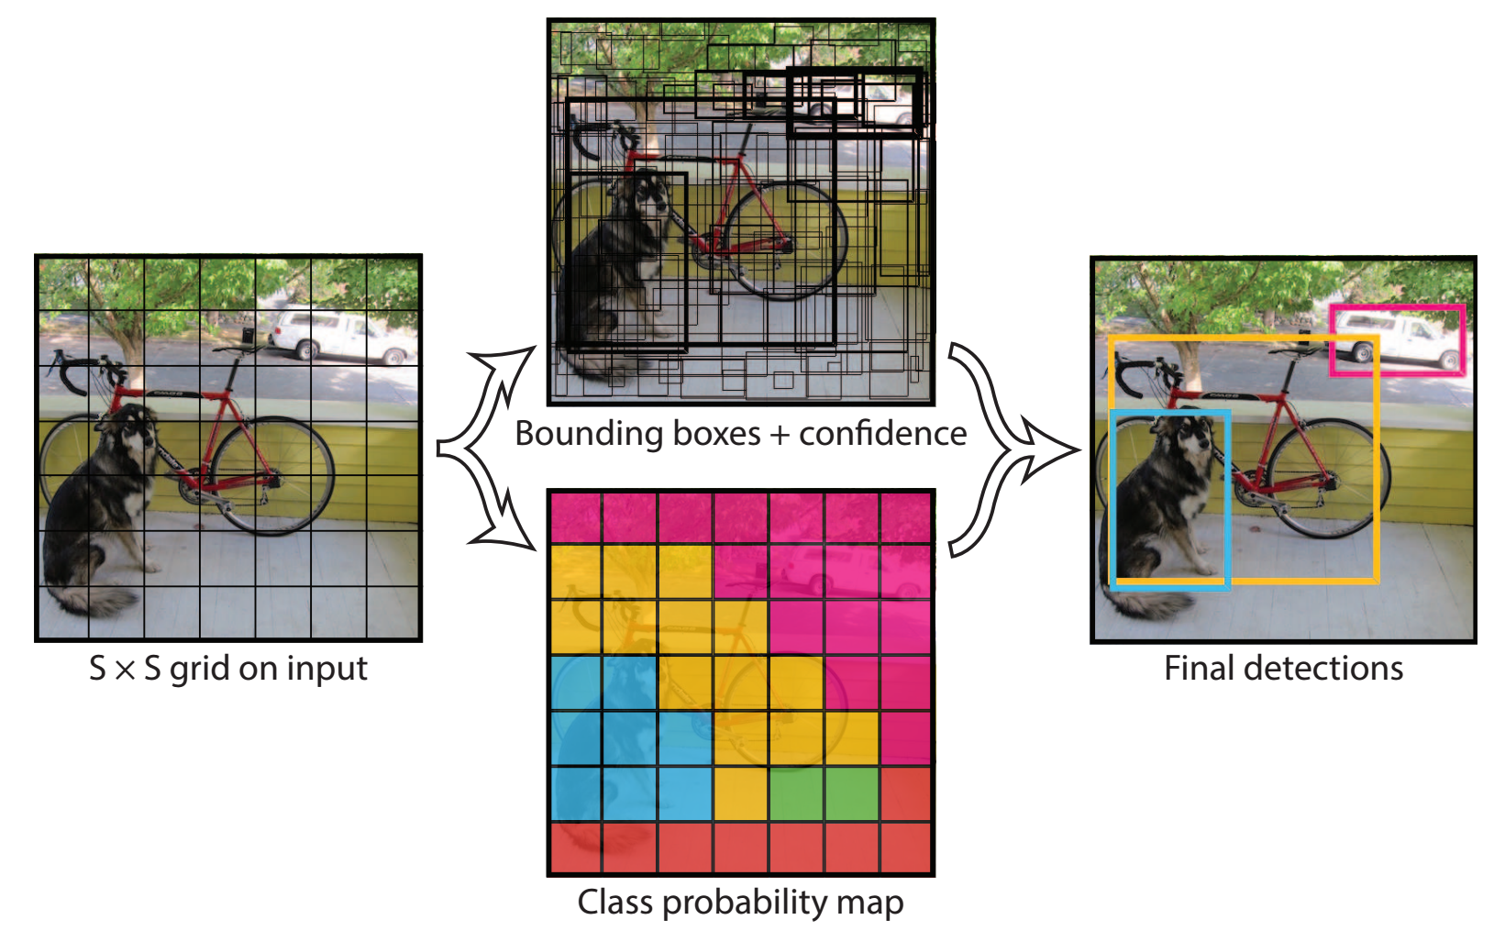
YOLO – You Only Look Once
Slice the image into cells
Every cell predicts for
Locations of bounding boxes and confidence scores
Class probabilities
Redmon, Joseph, et al. "You only look once: Unified, real-time object detection." CVPR (2016)

Slide 25
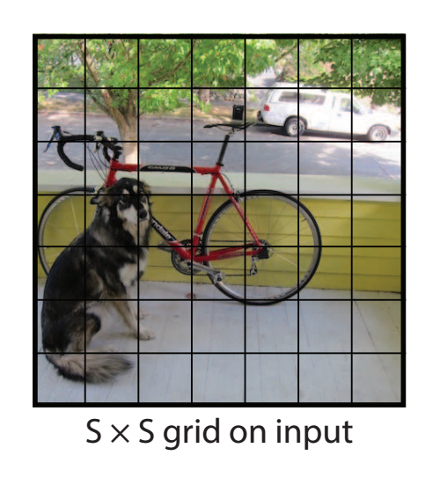
YOLO – You Only Look Once
Every cell predicts a number of B bounding boxes: [P_{c}, B_{x}, B_{y}, B_{w}, B_{h}]
P_{c}: Pr(obj) x IOU, the probability of an object in the cell x IOU between the predicted box and any ground truth box
B_{x}, B_{y}, B_{w}, B_{h}, object bounding box location (relative to the cell) and size (relative to the image)
Every cell also predicts C conditional class probabilities for all boxes:
C₁, C₂,…C_{n} : Pr(Class_{i} |obj = true) Give the cell contains an object, what is the probability of the object
[1, 0.5, 0.5, 5, 4, 0 ,1]
[1, 0.05, 0.5, 2.35, 4, 1 ,0]
dog, bike
https://www.coursera.org/learn/convolutional-neural-networks
https://polakowo.io/datadocs/docs/deep-learning/object-detection

Slide 26
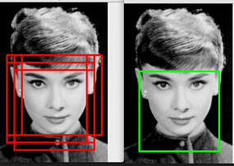
YOLO – You Only Look Once
Non-maximum suppression to merge detected boxes with high confidence
For each object class:
discard bounding boxes where probability of object being present is below some threshold, say 0.6
take the bounding box with the highest score,
discard any remaining bounding boxes with IOU value above some threshold (0.5)
https://www.coursera.org/lecture/convolutional-neural-networks/non-max-suppression-dvrjH

Slide 27
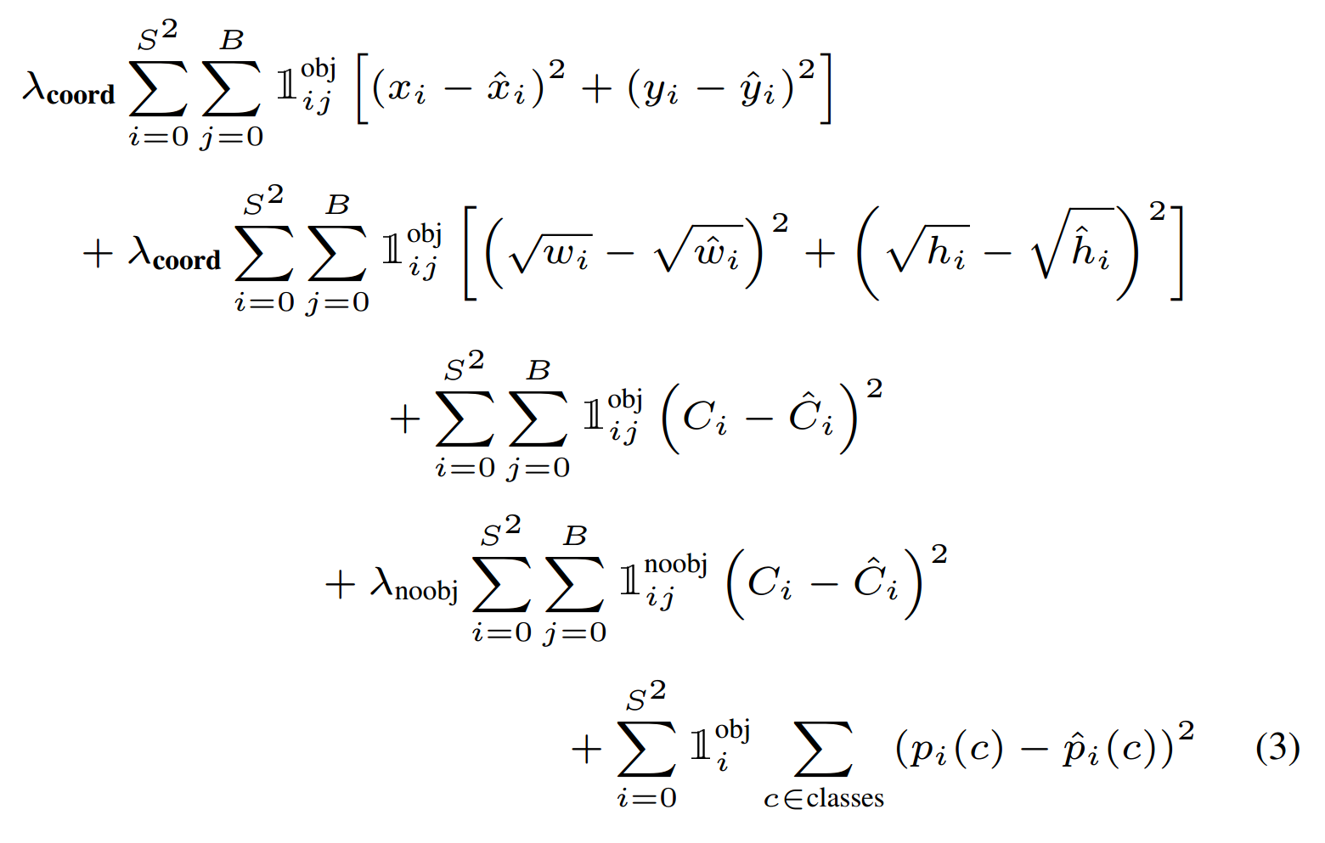
YOLO – You Only Look Once
After ImageNet pretraining, the whole network is trained end-to-end
The loss is a weighted sum of different regressions
Redmon, Joseph, et al. "You only look once: Unified, real-time object detection." CVPR (2016)

Slide 28
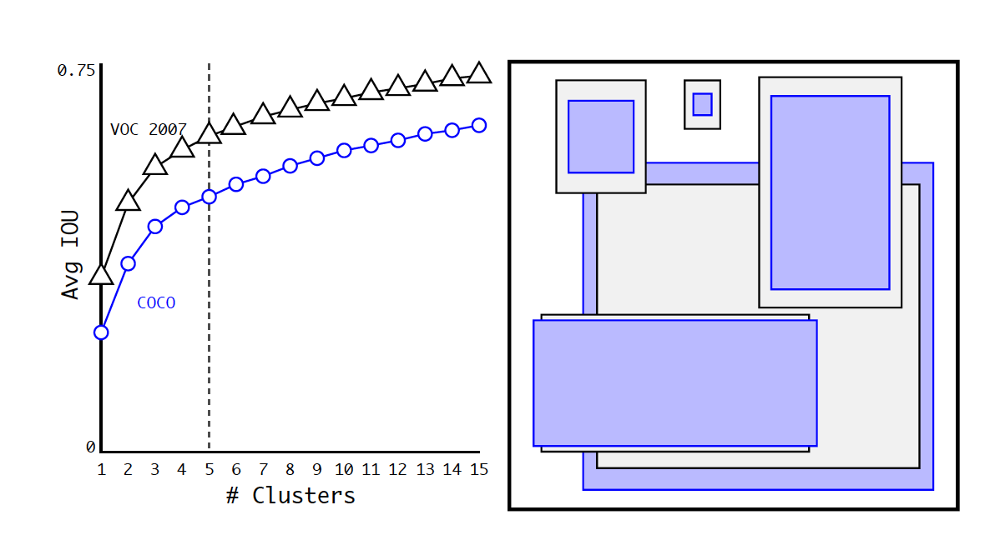

YOLO9000 / YOLOv2
Better, Faster, Stronger
Instead of directly predict any bounding box sizes from a cell, use anchor boxes as prior knowledge and then predict to adjust the boxes
Anchor boxes
Predefined dimensions of bounding boxes
Calculated from training data using K-Means with IOU as the distance measure
When K=5, every cell predicts to adjust 5 anchor boxes
Help detect multiple objects centered at a cell
Center all boxes and se IOU as the distance measure
https://vivek-yadav.medium.com/part-1-generating-anchor-boxes-for-yolo-like-network-for-vehicle-detection-using-kitti-dataset-b2fe033e5807

Slide 29
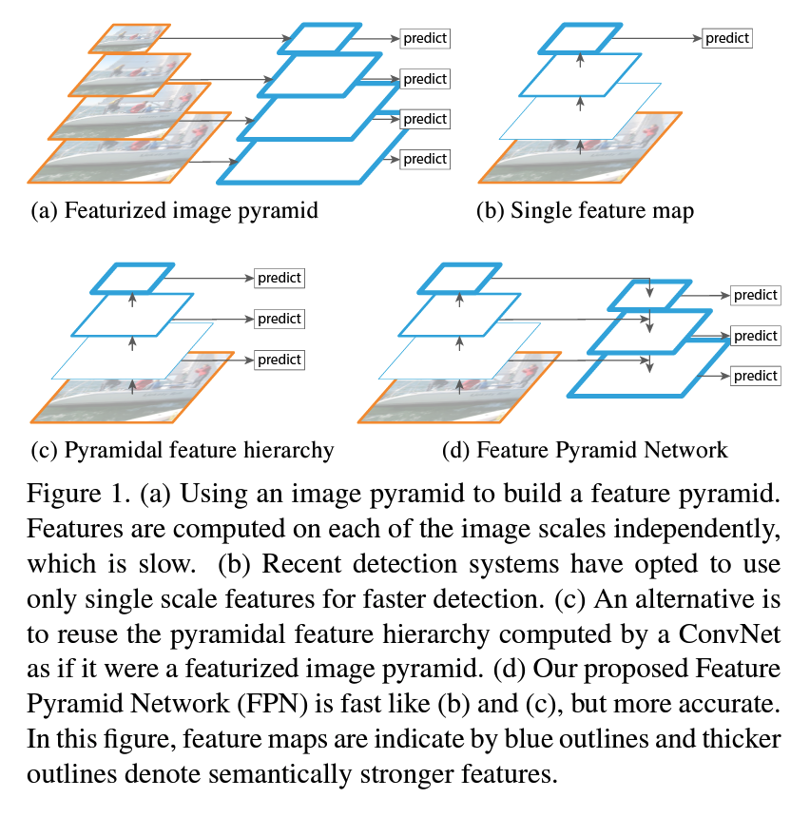
RetinaNet
One-stage object detection
Feature Pyramid Networks (FPN)
Effectively handle multiscale objects
FocalLoss
Help the networks to focus on hard classification
https://arxiv.org/abs/1612.03144

Slide 30
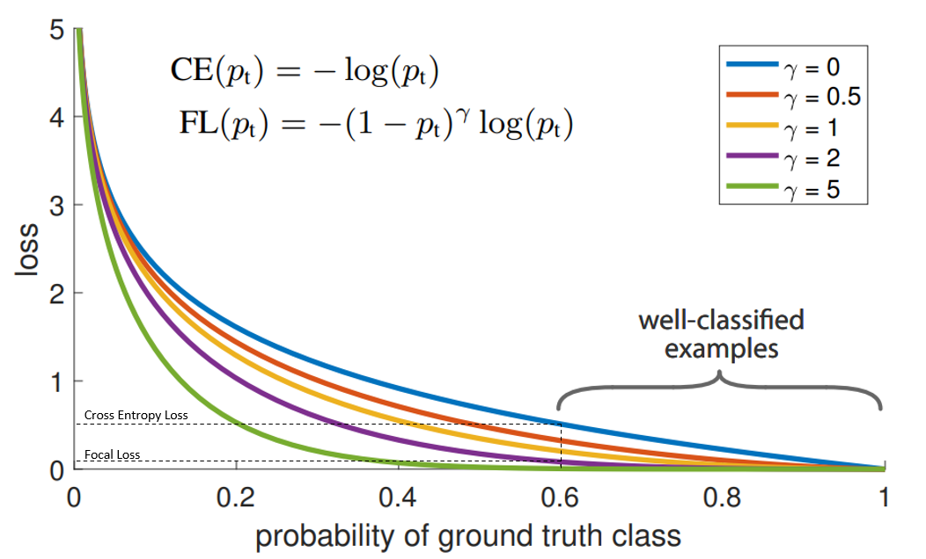
FocalLoss
Class Imbalance Problem
Information related to one class in a dataset used in training is over-represented than the other classes
Make the network biased towards learning more representations of the data-dominated class and other classes will be underlooked
Focal Loss
Reduce the loss for “well-classified examples” (e.g., p > 0.5 and it's correct)
Increase loss for “hard-to-classify examples” (e.g., p < 0.5)
Help the models focus on the rare class in case of class imbalance.
https://medium.com/visionwizard/understanding-focal-loss-a-quick-read-b914422913e7
https://amaarora.github.io/2020/06/29/FocalLoss.html
See also Dice Loss for semantic segmentation: https://www.youtube.com/watch?v=NqDBvUPD9jg

Slide 31
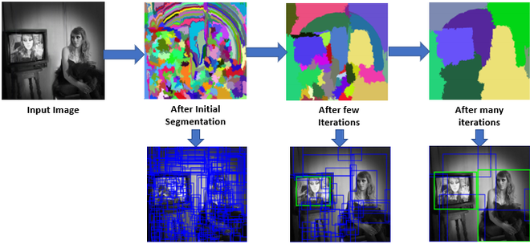
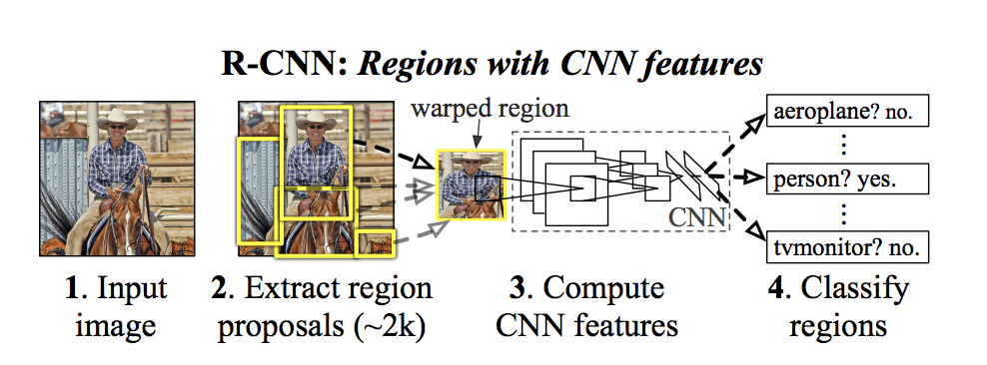
R-CNN
Selective search to find boxes of object candidates (slow, CPU time, 47 sec. per image) – recursively combine similar regions
ConvNet trained on individual regions
Predict a class label for each box using a support vector machine (SVM)
Predict offsets of the bounding boxes to improve box precision
https://www.geeksforgeeks.org/selective-search-for-object-detection-r-cnn/

Slide 32
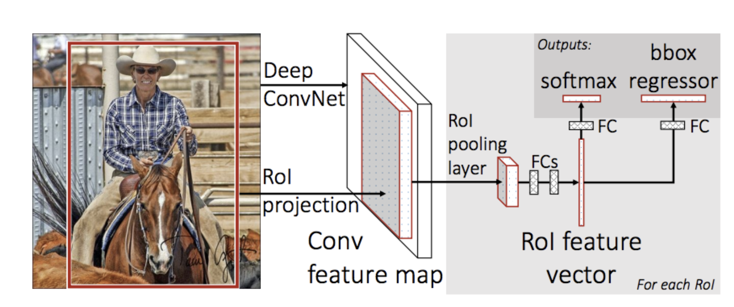
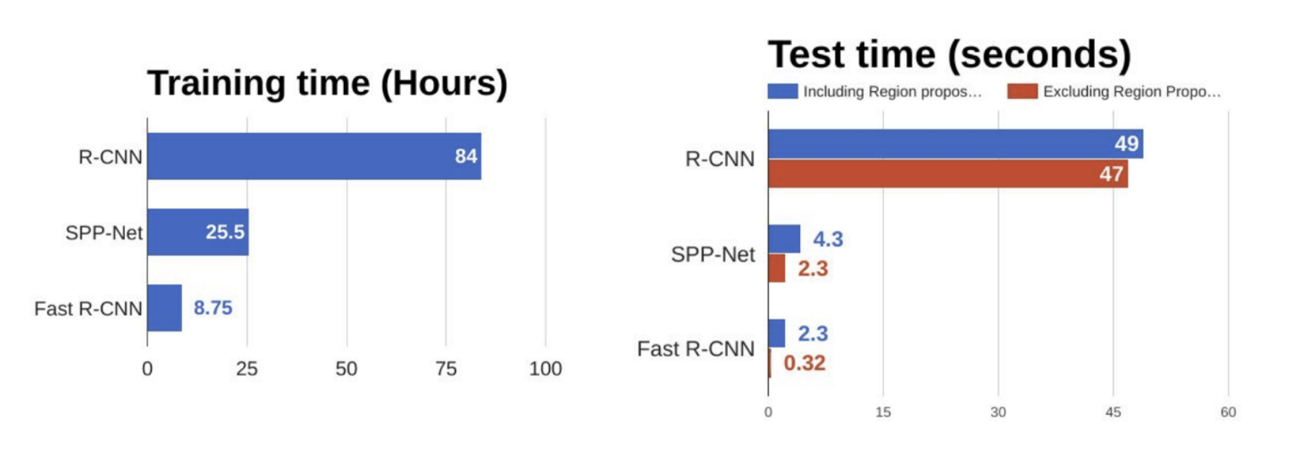
Fast R-CNN
Find regions of interest from the feature map (selective search, but instead of from the input image)
ConvNet trained on the entire image and use ROI pooling to generate fixed feature vector for each region for prediction
Much faster than R-CNN

Slide 33
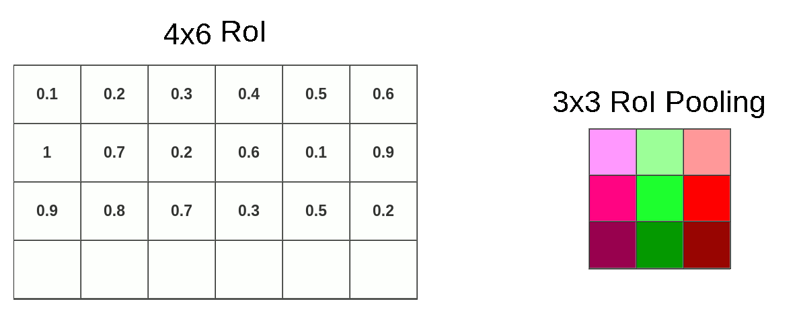
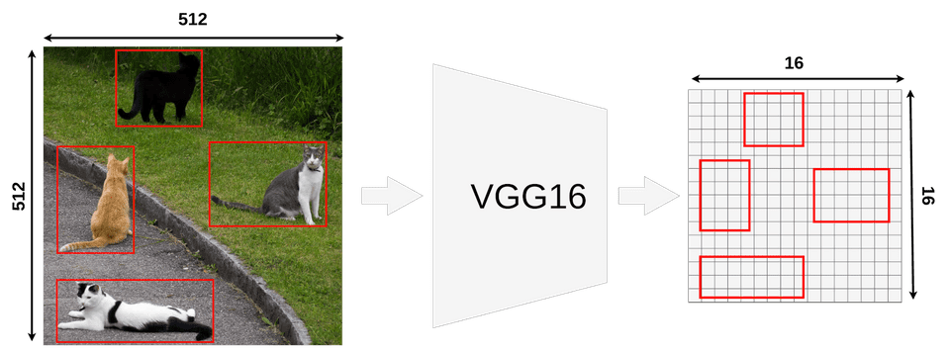
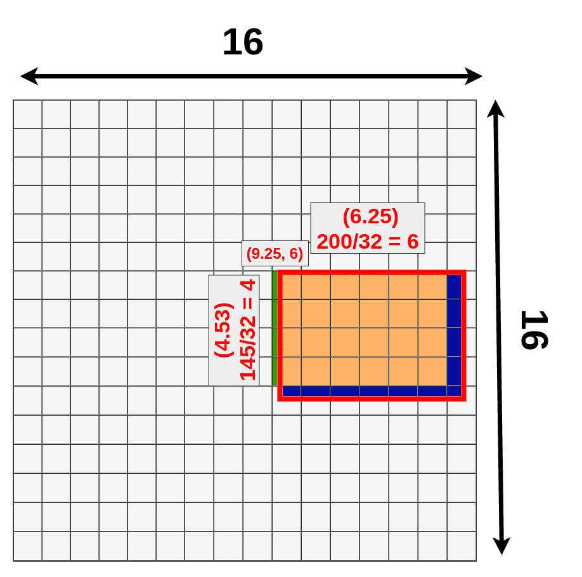
ROI pooling
Use ROI pooling to generate a fixed-size feature vector for each proposal for final classification
Allows to propagate gradient only on interesting regions, and efficient computation
Notes:
stop

Slide 34
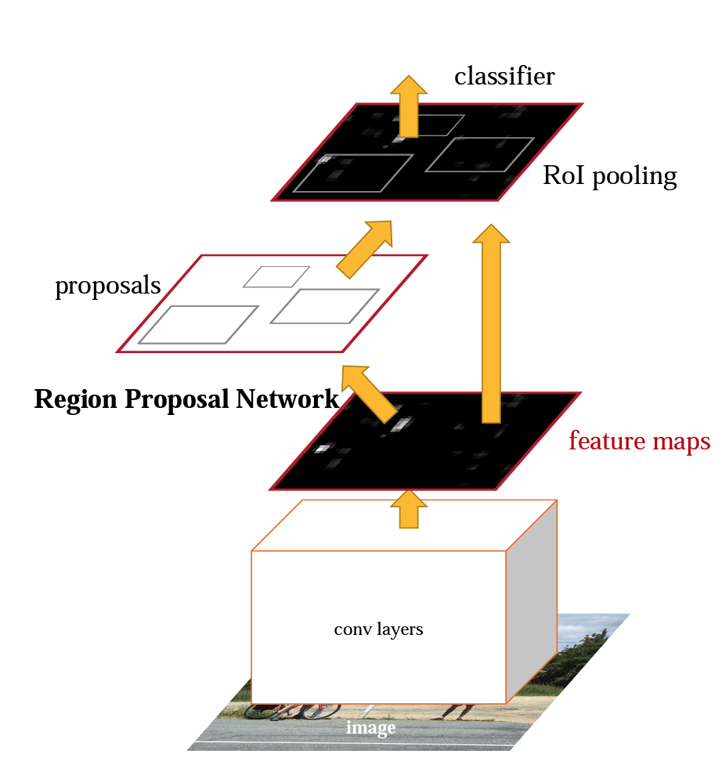
Faster-RCNN
Region proposal network (RPN): Take an image (of any size) as input and outputs a set of rectangular object proposals, each with an objectness score
Use anchor boxes
Lots of proposals (high recall, low precision)
Classification: decide if a proposed region has an object
Ren, Shaoqing, et al. "Faster r-cnn: Towards real-time object detection with region proposal networks." NIPS 2015

Slide 35
Object Detection Summary
YOLO family
One stage
Very fast, better than real-time (45 – 150 frames per second)
Might have lower recall compared to Faster RCNN
Need to work on the entire image – imbalanced training data, see FocalLoss for dealing with this problem: Lin, Tsung-Yi, et al. "Focal loss for dense object detection." ICCV 2017.
Might not work well for small objects
Faster RCNN family
Two stage
The second stage can focus on ROI proposals
Might be slower than YOLO

Slide 36
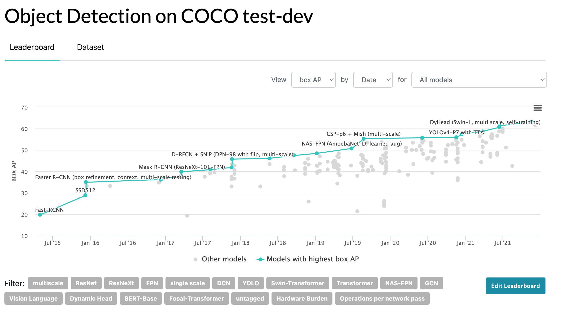
https://paperswithcode.com/sota/object-detection-on-coco

Slide 37
Object Detection + Semantic Segmentation

Slide 38
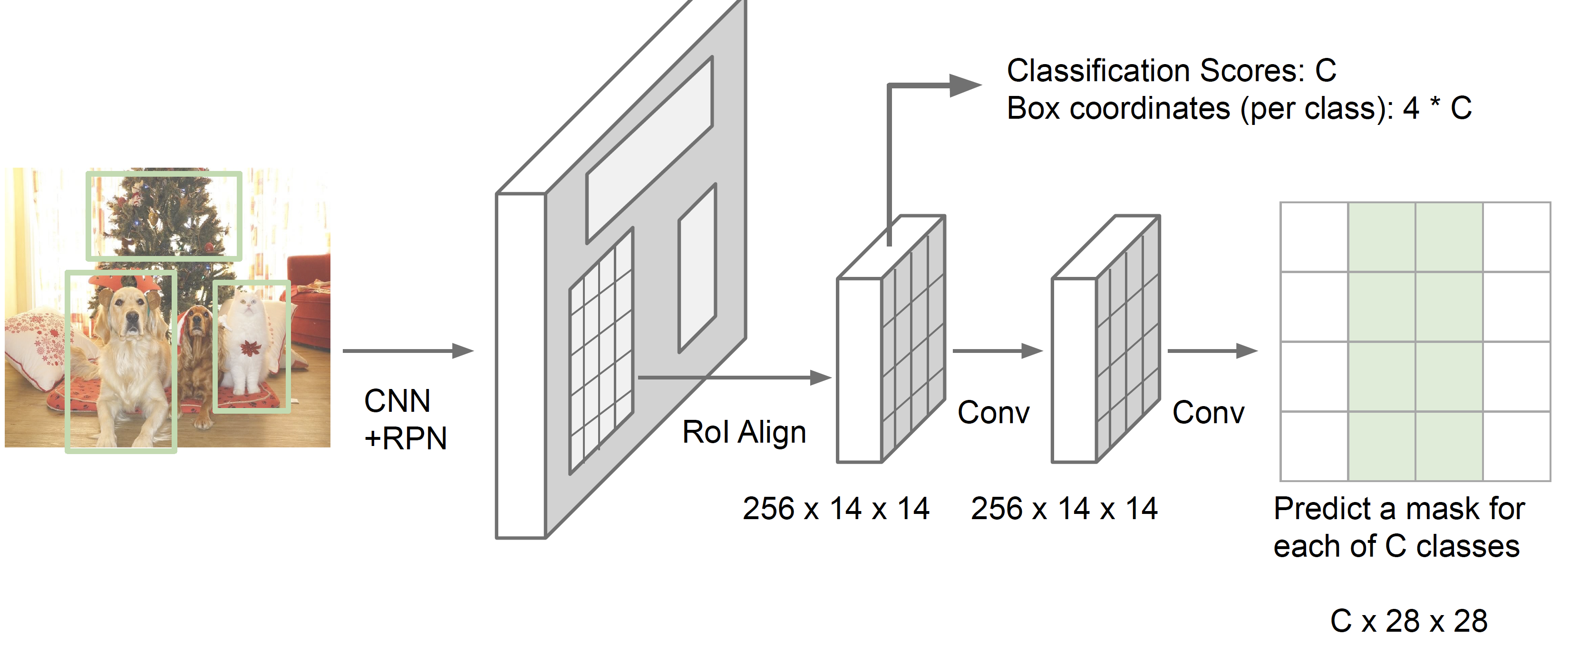
Instance Segmentation: Mask R-CNN
FCN
Faster R-CNN
Fei-Fei Li, Ranjay Krishna, Danfei Xu.
He et al, “Mask R-CNN”, arXiv 2017

Slide 39
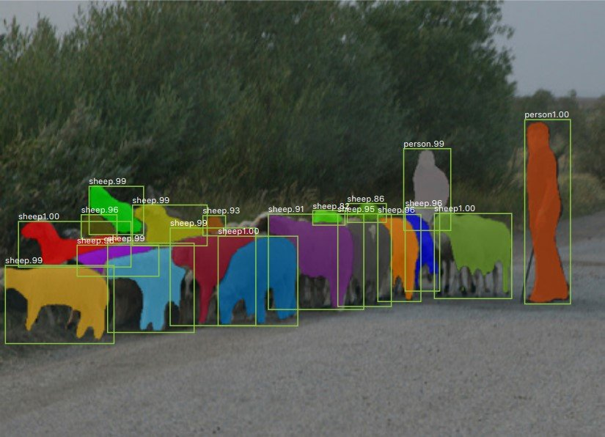
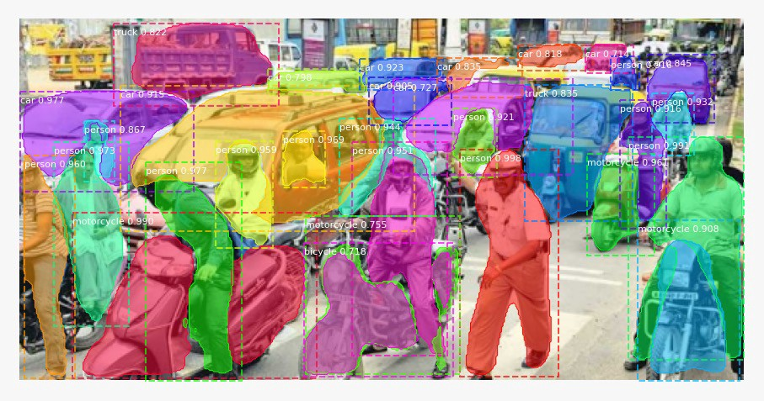
Mask R-CNN Results

Slide 40
Overhead Imagery Understanding

Slide 41
Overhead Imagery Understanding Tasks
Typically customize existing CV models with pretrained weights
YOLO or Faster R-CNN for object detection
Unet or similar architecture for semantic segmentation
Thorsten Hoeser and Claudia Kuenzer. 2020. Object detection and image segmentation with deep learning on earth observation data: A review-part i: Evolution and recent trends. Remote Sensing. Retrieved from https://www.mdpi.com/723500

Slide 42
Open Challenges
The need of customization of network architectures come from open challenges in dealing with overhead imagery
Small objects
Imbalanced data, inconsistent training data domain (e.g., scenic photos vs overhead imagery)
Large search space/large image
Multi-scale
Multi-orientation
Multi-bands
Occlusion (camera angle or vertical occlusion)
Varying imagery quality (shadows, cloud covers, over/under-exposition)

Slide 43
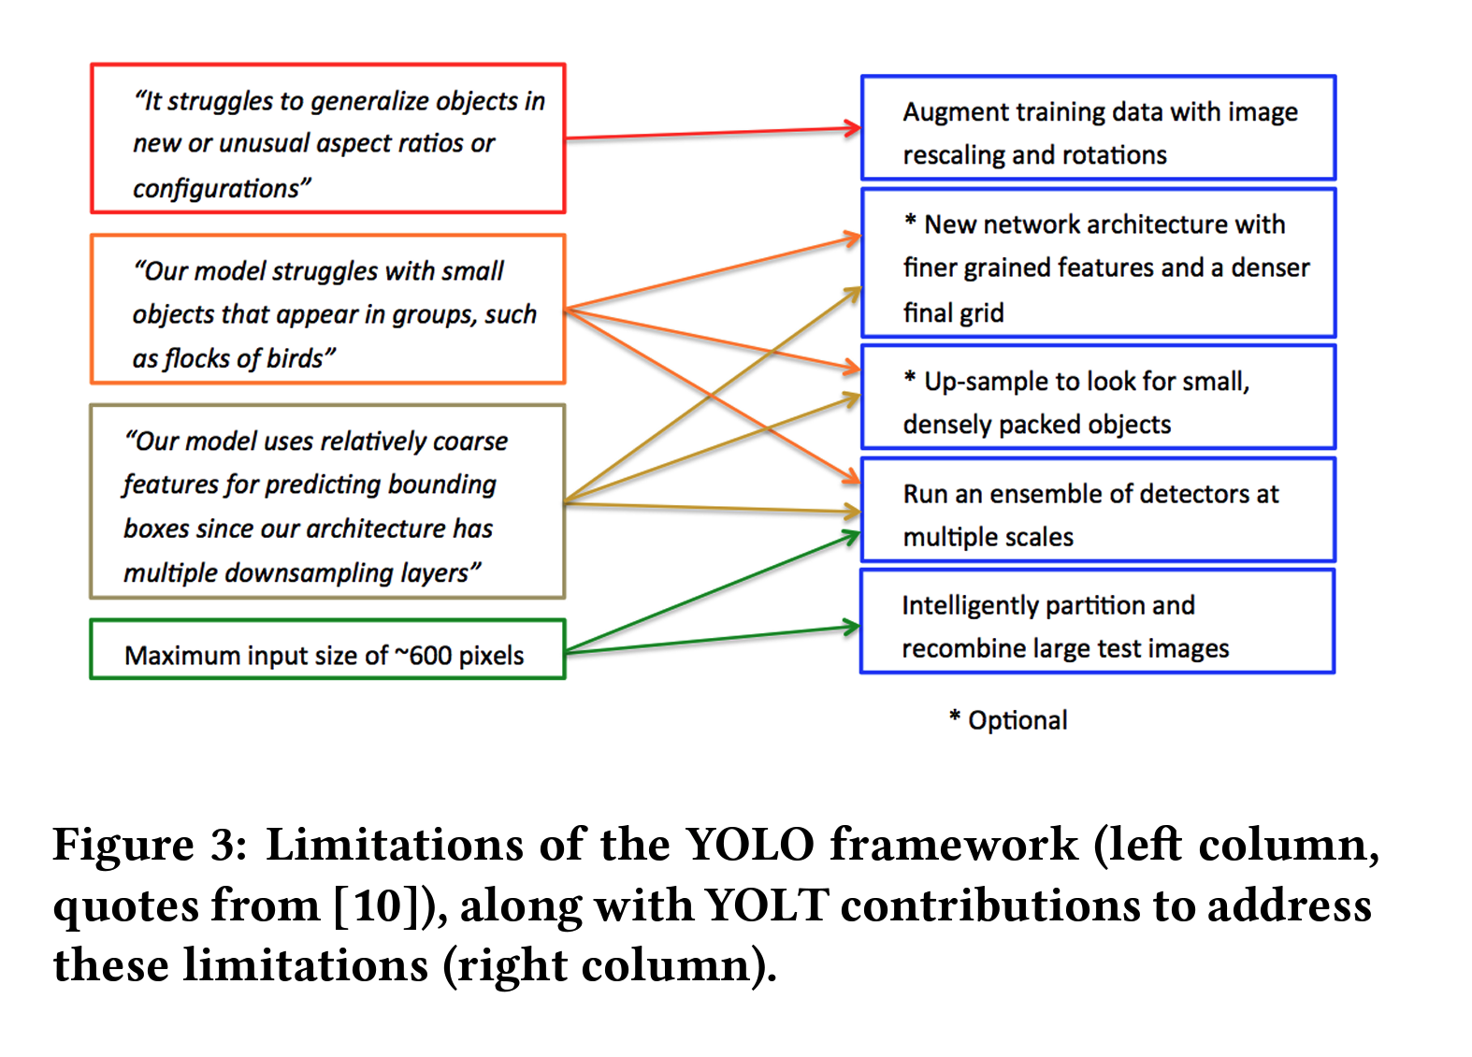
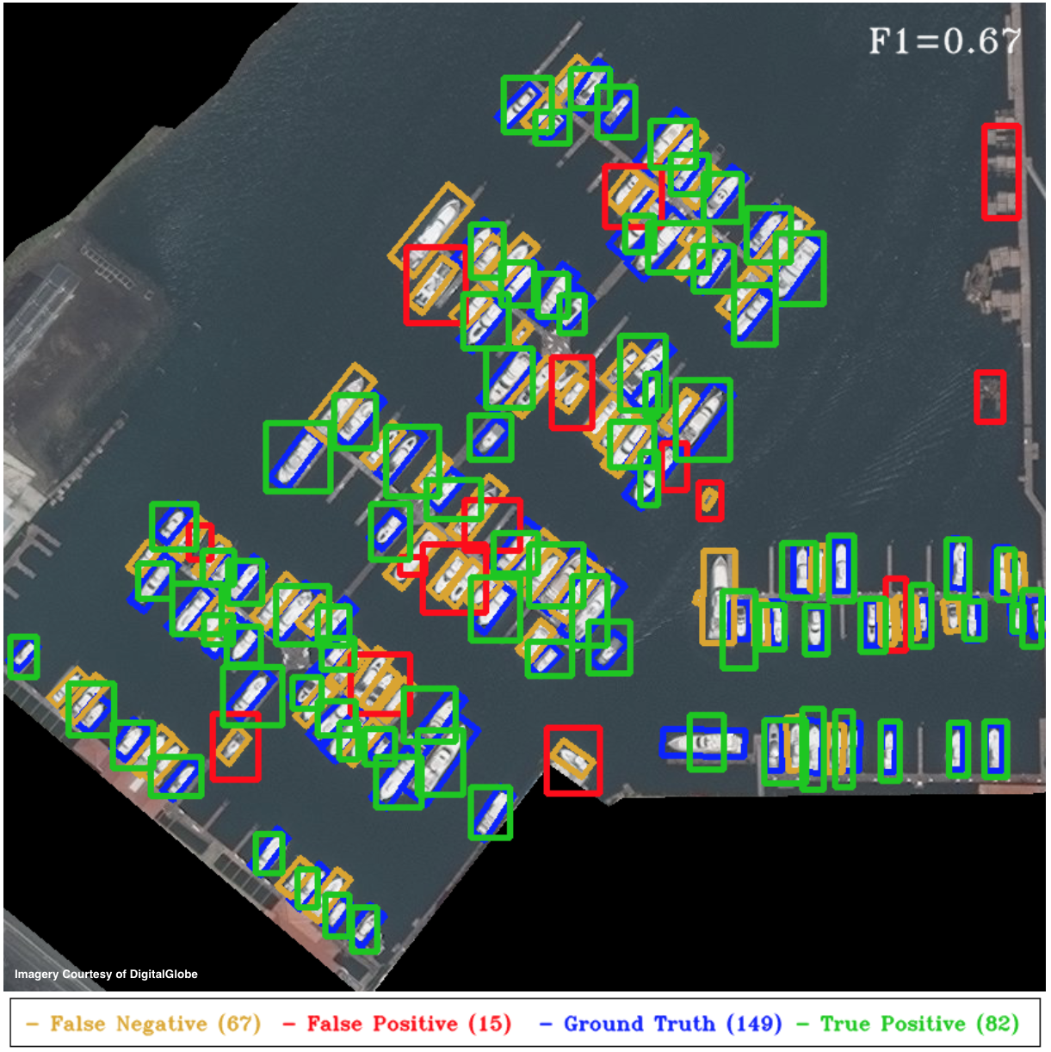
You Only Look Twice: Rapid Multi-Scale Object Detection In Satellite Imagery
https://arxiv.org/abs/1805.09512
https://medium.com/the-downlinq/you-only-look-twice-multi-scale-object-detection-in-satellite-imagery-with-convolutional-neural-38dad1cf7571

Slide 44
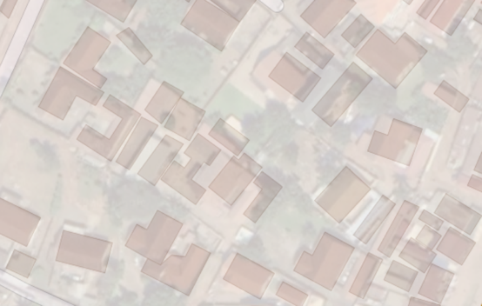
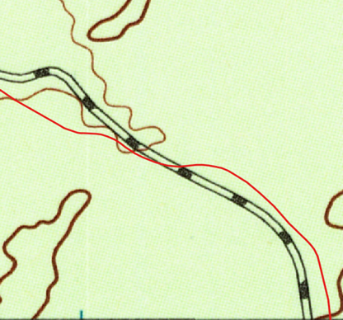

Generating Location Specific Training Data
Location is the key to link various types of data
e.g., can provide context-rich annotated (training) data (if we do it correctly)
Positional offsets: buildings are not aligned
&
Content inconsistency:
One building vs. multiple
“By using the data in OSM, we were able to collect more than 100 million labeled examples to add to our training data set.”
“However, using OSM data for labels presented several challenges that required novel approaches to overcome.”
Facebook Map with AI
USGS Railroads
Data scale/representation conflict
USGS historical topo. map
https://ai.facebook.com/blog/mapping-the-world-to-help-aid-workers-with-weakly-semi-supervised-learning/
Label road locations on imagery with OpenStreetMap data

Slide 45
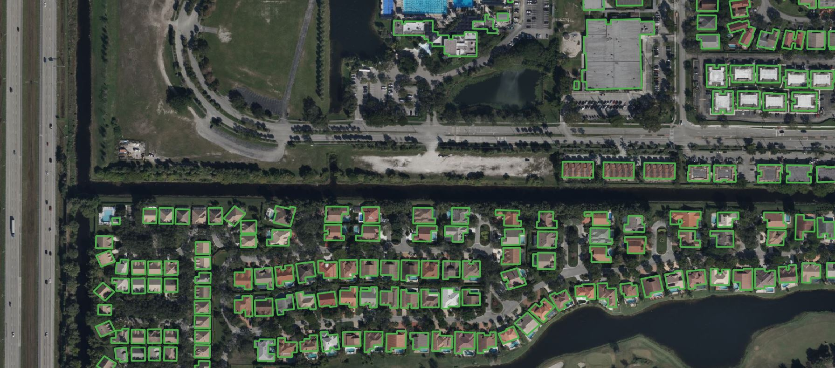
Microsoft Building Footprints
https://www.microsoft.com/en-us/maps/building-footprints

Slide 46
Conflation: Generating your own training data
A short introduction

Slide 47
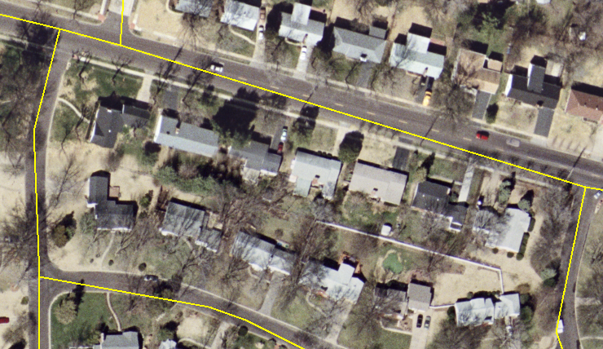
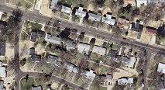
Conflation
Integrating multiple geo-spatial datasets by establishing the correspondence between matched entities (control point pairs) and transforming the other objects accordingly

Slide 48
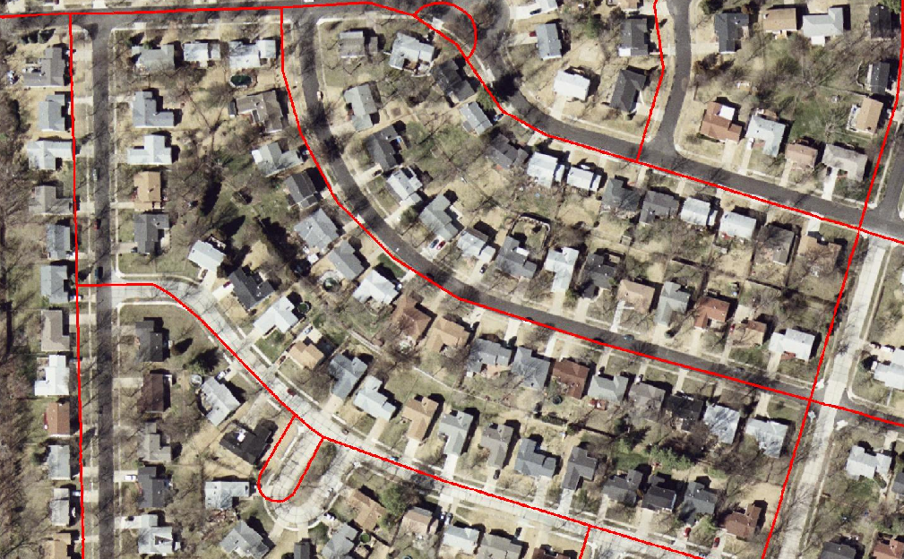
Conflation

Slide 49
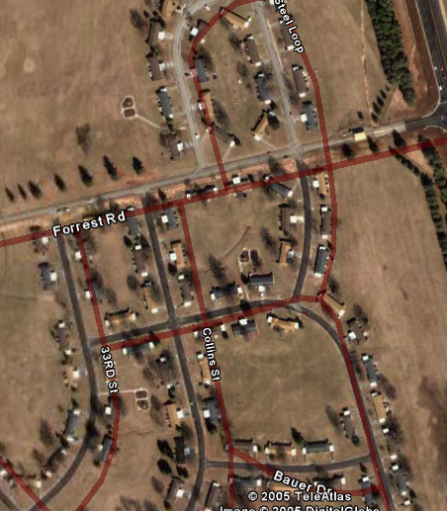
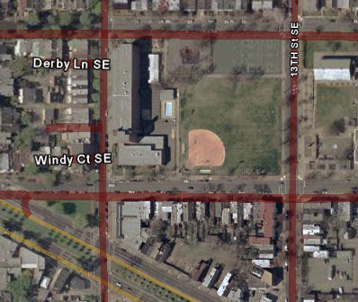
Challenges
Different projections, accuracy levels, resolutions
Result in spatial inconsistencies
D.C.
Ft. Campbell, KY (only zoom into 1m/p)

Slide 50
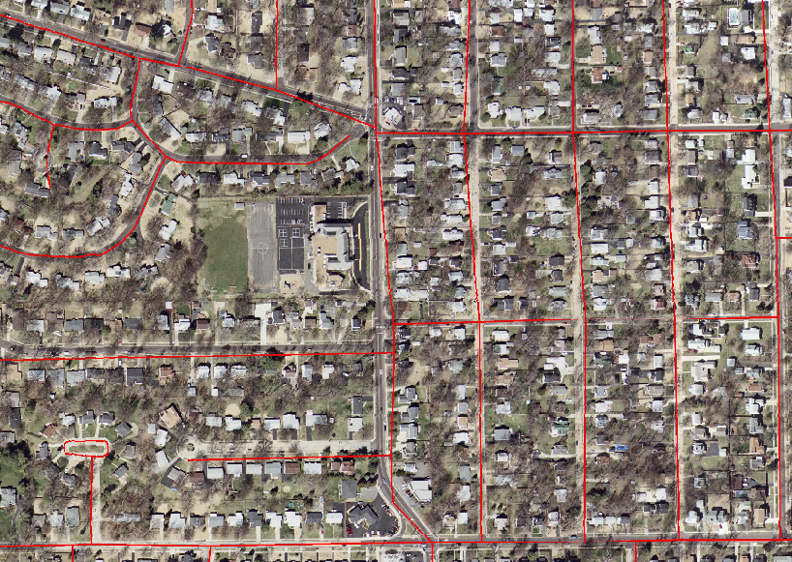
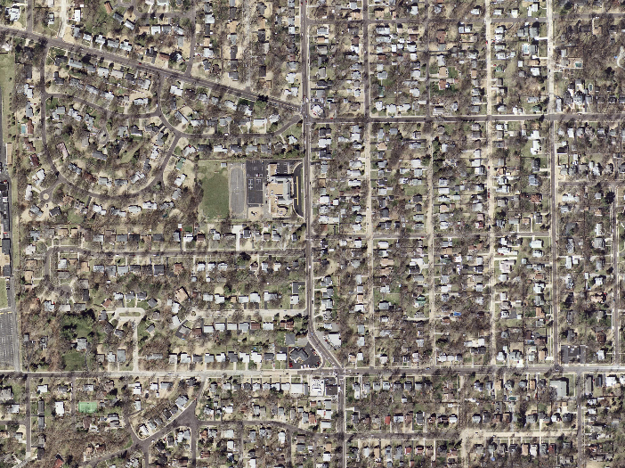
AMS-Conflation to Align Vector and Imagery
Lat / Long
Filtering Technique
Triangulation and Rubber-Sheeting
Final control points
Intermediate control points
Control Point Detection
Lat / Long
Lat / Long
https://link.springer.com/article/10.1007/s10707-006-0344-6
Lat / Long

Slide 51


Localized Template Matching (LTM)
Bayes Classifier
road width and road directions
Matching by Correlation
https://link.springer.com/article/10.1007/s10707-006-0344-6

Slide 52

Filtering Control Point Pairs Using Vector Median Filter (VMF)
Y (meter)
k% control-point
vector
Vector median
10
X (meter)
O
-10
10
-10
W
https://link.springer.com/article/10.1007/s10707-006-0344-6

Slide 53


Triangulation & Rubbersheeting
Delaunay triangulation on the CP pairs (maximize the minimum angle of all the angles of the triangles)
Use the 3 CP pairs for each triangle to calculate a transformation matrix
Transform data within each triangle according to the matrix
https://desktop.arcgis.com/es/arcmap/10.3/tools/editing-toolbox/generate-rubbersheet-links.htm
https://en.wikipedia.org/wiki/Delaunay_triangulation

Slide 54

MO-DOT+ High-resolution USGS Color Image
Red lines: Original MO-DOT
Blue lines: Conflated lines

Slide 55

NAVSTREETS+ High-resolution USGS Color Image
Red lines: Original NAVSTREETS roads
Yellow lines: Conflated lines

Slide 56



Conflation Results: Parcel data

Slide 57



Matching Point Sets for Conflation
Lat / Long
Sometimes one data source does not provide the exact geocordinates
Find salient features from both datasets for matching
e.g., road intersections
A point pattern matching problem
?
Lat / Long
?
https://doi.org/10.1145/1032222.1032231

Slide 58
Point Pattern Matching
Pick a pair of points in first dataset

Slide 59
Point Pattern Matching
Pick a pair of points in first dataset
Pick two random points in the second dataset

Slide 60
Point Pattern Matching
Pick a pair of points in first dataset
Pick two random points in the second dataset
Apply the same transformation all points
Calculate the number of matches
Complexity is very high!
Repeat until every point has a match

Slide 61


GeoPPM: Exploit Connectivity
P₁
Light Green: Impossible candidates for P₁
Orange: Possible candidates for P₁

Slide 62
GeoPPM: Exploit Orientation
P₁
Orange: Possible candidates for P₁
Light Green: Impossible candidates for P₁

Slide 63
GeoPPM: Exploit Angles between Points
P₁
P₂
Some of the possible candidate pairs for P₁,P₂
Some of the impossible candidate pairs for P₁,P₂

Slide 64
GeoPPM: Exploit Density between Points
P₁
P₂
Some of the possible Candidate pairs for P₁,P₂
Some of the impossible Candidate pairs for P₁,P₂

Slide 65

Conflation Summery
We can integrate geographic data from different sources by establishing correspondence between datasets
Conflation helps
generate accurate training data for imagery understanding (and other machine learning tasks)
integrate the extracted data from imagery to existing data
https://ai.facebook.com/blog/mapping-roads-through-deep-learning-and-weakly-supervised-training/

Slide 66


One more thing: EarthScan
How to effectively exploit prior knowledge of things in space for
Detecting objects from overhead imagery using reduced numbers and varieties of annotated visual samples, and
Parsing overhead imagery into complete geographic layers
Duan, et al. A Label Correction Algorithm Using Prior Information for Automatic and Accurate Geospatial Object Recognition. IEEE BigData
Duan, et al. Guided Generative Models using Weak Supervision for Detecting Object Spatial Arrangement in Overhead Images. IEEE BigData

Slide 67
Resources
Datasets: https://github.com/chrieke/awesome-satellite-imagery-datasets
Methods/Code: https://github.com/robmarkcole/satellite-image-deep-learning

Slide 68
Acknowledgements
Deep learning slides adapted from https://m2dsupsdlclass.github.io/lectures-labs/ by Olivier Grisel and Charles Ollion (CC-By 4.0 license)
Gil, Yolanda (Ed.) Introduction to Computational Thinking and Data Science. Available from http://www.datascience4all.org

Slide 69

These materials are released under a CC-BY License
https://creativecommons.org/licenses/by/2.0/
You are free to:
Share — copy and redistribute the material in any medium or format
Adapt — remix, transform, and build upon the material
for any purpose, even commercially.
The licensor cannot revoke these freedoms as long as you follow the license terms.
Under the following terms:
Attribution — You must give appropriate credit, provide a link to the license,
and indicate if changes were made. You may do so in any reasonable manner,
but not in any way that suggests the licensor endorses you or your use.
Artwork taken from other sources is acknowledged where it appears.
Artwork that is not acknowledged is by the author.
Please credit as: Chiang, Yao-Yi Introduction to Spatial Artificial Intelligence. Available from https://yaoyichi.github.io/spatial-ai.html
If you use an individual slide, please place the following at the bottom: “Credit: https://yaoyichi.github.io/spatial-ai.html
We welcome your feedback and contributions.
Credit: http://www.datascience4all.org/

